Slide 1
Chapter 3:
Concepts in Robotics
Part - 3

Slide 2
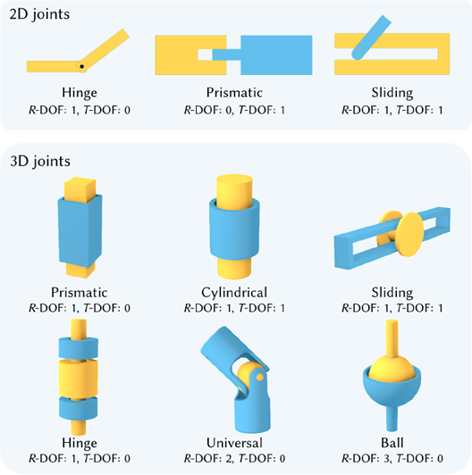
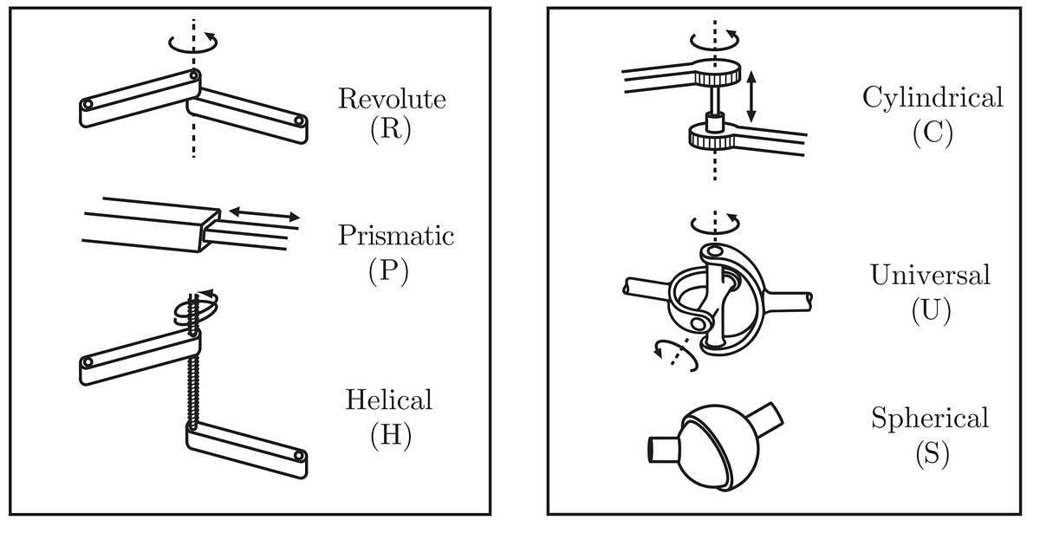
Concept of Joints in Robotics
Definition
A joint is a mechanical connection between two or more robotic links that allows relative motion. Joints provide flexibility and mobility, enabling robots to perform tasks with different configurations.
Common Types of Robotic Joints
Revolute Joint
Prismatic Joint
Spherical Joint
Cylindrical Joint
Universal Joint
Helical Joint

Slide 3
Concept of Joints in Robotics
Prismatic Joint
What is Prismatic Joint?
Definition
A Prismatic Joint—also known as a sliding joint—allows linear motion along a single axis. It enables one robotic link to move straight relative to another.
Structure & Mechanism
Uses sliding mechanisms (e.g., rails or tracks)
Keeps links aligned and supported during motion
Often found in linear actuators (e.g., telescoping booms)
Examples
Robotic arms (straight-line movement of tools/grippers)
Assembly lines
Pick-and-place systems
Material handling robots

Slide 4
Concept of Joints in Robotics
Revolute Joint
What is Revolute Joint?
Definition
A Revolute Joint—also known as a hinge/rotary joint—allows rotational motion along a single axis. It allows the rotation of the limb.
Structure & Mechanism
One link is connected to another through a pivot mechanism
It allows the links to rotate around single axis
The joint includes bearing for the support
Examples
Elbow Joint of Humanoid Robot
Pick-and-place systems
Material handling robots

Slide 5
Concept of Joints in Robotics
Spherical Joint
What is Spherical Joint?
Definition
A Spherical Joint (Ball-and-socket joint)—allows for the rotational motion in multiple axis. It is used in the shoulder joint to give high DOF.
Structure & Mechanism
One link is connected to another a ball-shaped mechanism
It allows the links to rotate around multi-axis
The joint includes bearing for the support
Examples
Shoulder Joint of Humanoid Robot
Robotic Hand and Fingers

Slide 6
Concept of Joints in Robotics
Helical Joint
What is Helical Joint?
Definition
A Helical Joint (screw/helical screw joint) — allows for the rotational motion and also providing translation along that same axis.
Structure & Mechanism
Both the links are rotated through the screw along its axis
As screw rotates, it also moves linearly along the axis.
Also, used with other types of join like revolute and prismatic joint
Examples
Robotic Arms and Legs

Slide 7
Concept of Joints in Robotics
Cylindrical Joint
What is Cylindrical Joint?
Definition
A Cylindrical Joint (prismatic-rotary joint) — allows for translational motion along linear axis and rotational motion around same axis.
Structure & Mechanism
One link is connected to another through a helical/screw mechanism
It moves along a straight line while also rotating.
Examples
Robotic Arms

Slide 8
Concept of Joints in Robotics
Universal Joint
What is Universal Joint?
Definition
A Universal Joint (U-joint) — allows for the rotational motion around two perpendicular axes.
It is type of joint used in robotics that allows rotating motion around two non-parallel axes.
Structure & Mechanism
Two yokes/forks are connected by a cross-shaped pivot that rotates yokes
relative to each other around two non-parallel axes
Examples
Robotic Drive Trains, Automobiles

Slide 9
Concept of Links in Robotics
A link is a body that connects two or more joints to make the robot work.
These are the part of kinematic chain of the robot that
Structure & Mechanism
Both the links are rotated through the screw along its axis
As screw rotates, it also moves linearly along the axis.
Also, used with other types of join like revolute and prismatic joint
Examples
Robotic Arms and Legs

Slide 10
Degree of Freedom in Robotics
Universal Joint
What is Universal Joint?
Definition
A Universal Joint (screw/helical screw joint) — allows for the rotational motion and also providing translation along that same axis.
Structure & Mechanism
Both the links are rotated through the screw along its axis
As screw rotates, it also moves linearly along the axis.
Also, used with other types of join like revolute and prismatic joint
Examples
Robotic Arms and Legs

Slide 11
Thanks For Joining
^_^

