Slide 1
Chapter 3:
Concepts in Robotics
Part - 2

Slide 2
Understanding the Concept of Robotics
In order to make robots work, there are some key components that are required:
Key Components: Motion, Joints, and Links
Manipulation: Enables robots to pick, move, or assemble objects (e.g., robotic arms).
Mobility: Allows robots to navigate environments (wheeled, legged robots).
Precision: Ensures high accuracy in tasks like microsurgery or electronics assembly.
Versatility: Multiple joints/links help switch tools for tasks like welding, painting.
Safety: Motion planning and sensors prevent collisions and ensure safe interaction.

Slide 3
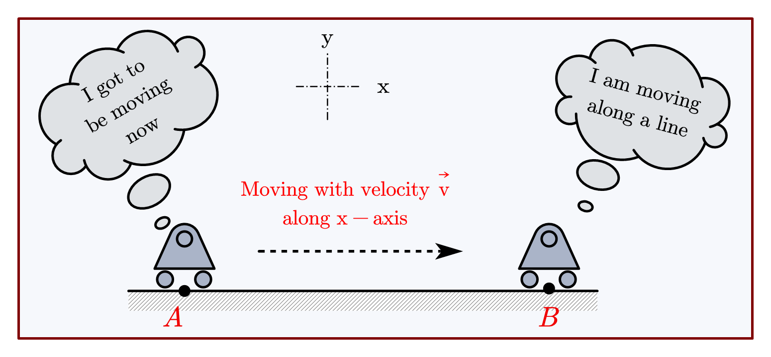
Translational Motion

Slide 4
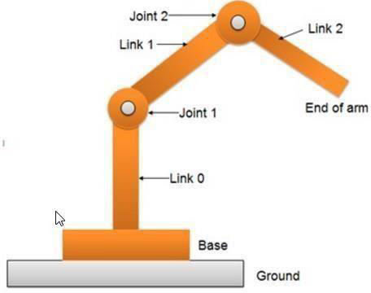
Understanding the Concept of Robotics

Slide 5
Concepts of Motion in Robotics with Examples
Linear Motion
What is Linear Motion?
Also called translational motion
Refers to movement in a straight line, not around an axis
Moves robot links or end effectors along a direct path
Examples
A robotic arm moving up and down
A wheeled robot moving forward/backward
A robot on a conveyor belt placing parts
How Is Linear Motion Achieved?
Prismatic Joints: Allow linear movement along one axis
Linear Actuators:
- Convert rotational motion into linear motion
- Use motors, gears, and rails
Sliding Mechanisms: Provide smooth linear displacement
Wheels or Tracks: Enable straight-line mobility in mobile robots

Slide 6
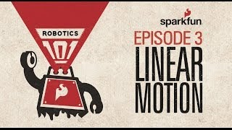
Linear Motion

Slide 7
Concepts of Motion in Robotics with Examples
Rotational Motion
What is Rotational Motion?
Also known as angular motion
Involves movement around a fixed point or axis
Common in robotic arms, wheels, joints, and cameras
Examples of Rotational Motion
Robotic arm rotating at a joint to change angle
Gripper rotating to grasp an object
Camera pivoting for inspection or surveillance
Robot rotating tools for welding or painting
How Is Rotational Motion Achieved?
Revolute Joints (Rotary Joints):
Allow rotation around one axis
Rotary Actuators:
Motors and gears generate rotation
Gears & Linkages:
Transfer rotational motion to different parts of the robot

Slide 8
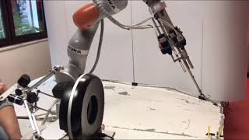
Rotational Motion

Slide 9
Concepts of Motion in Robotics with Examples
Reciprocating Motion
Definition
Reciprocating motion refers to the back-and-forth linear movement of a robotic component or mechanism.
It involves alternating motion between two fixed points along a straight path.
Examples of Reciprocating Motion
Assembly Lines – Repeated linear actions like pressing, cutting, or inserting.
Piston Engines – Convert combustion energy into rotational motion.
How It Works
Mechanisms Used:
  Slider-Crank Mechanism
  Converts rotational motion into linear reciprocating motion.
  Often involves a rotating crank connected to a linear slider

Slide 10
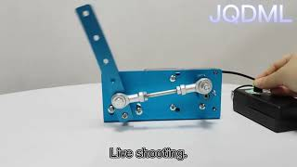
Reciprocating Motion

Slide 11
Concepts of Motion in Robotics with Examples
Translational Motion
What Is Translational Motion?
Movement of a robot or its parts along a straight line.
No rotation or pivoting—pure linear motion.
Example: Like a train on a track or car on a road.
Examples of Translational Motion
Medical Robotics: Deliver medication or perform linear surgical tasks.
Manufacturing: Move along a conveyor to pick/place parts.
How It’s Achieved
Prismatic Joints (Slider Joints)
Enable motion along a single axis.
Linear Actuators
Use motors/gears to move in one or multiple directions.

Slide 12
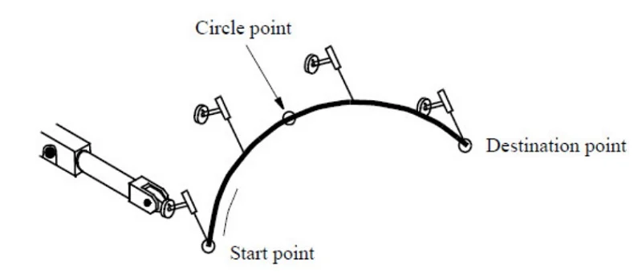
Concepts of Motion in Robotics with Examples
Oscillatory Motion
Oscillatory motion in robotics refers to a type of periodic, repetitive motion in which a robot or its components move back and forth around a fixed point or axis.
Oscillatory motion is achieved using mechanisms like harmonic drives, oscillating cams, crankshafts, and linkages, which convert rotary motor movements into controlled oscillations.
Examples of Translational Motion
The swinging of a robotic arm in sanding or polishing operations.
Vibrating robots used for cleaning or removing debris.
Vibratory feeders, which use oscillation to sort or move parts.
Oscillatory motion plays a vital role in tasks that require precision, repeatability, and controlled vibration, such as in:
Polishing, deburring, and cleaning operations.
Medical devices that require delicate and rhythmic movements.
Scientific instruments that demand fine vibration control.

Slide 13
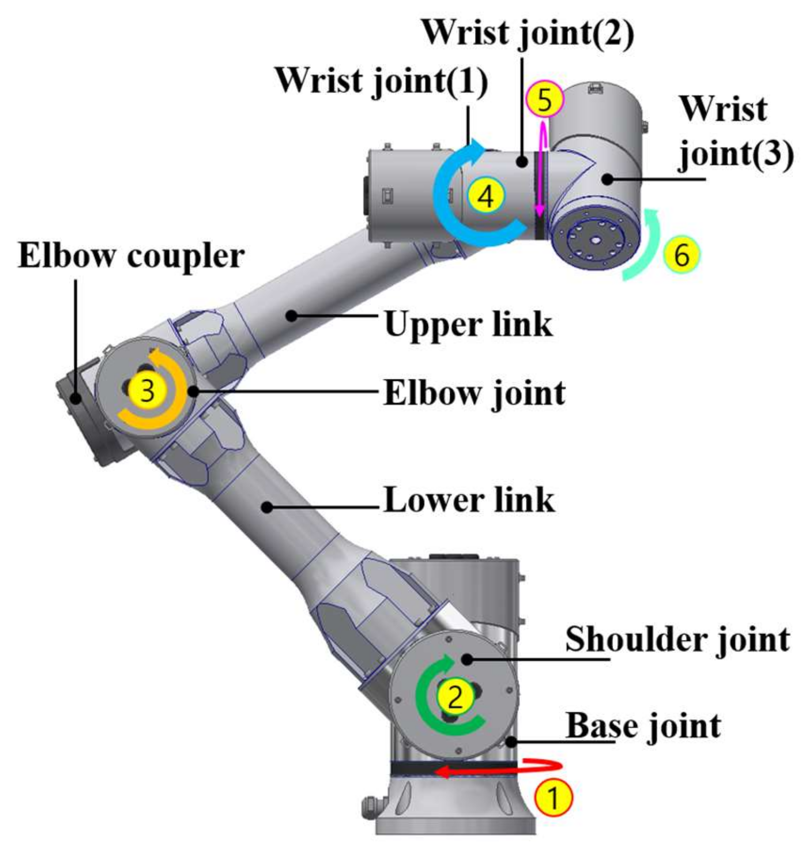
Concepts of Motion in Robotics with Examples
Articulated Motion
Articulated motion refers to the movement of a robot's joints or limbs, enabling complex, flexible, and human-like motion. It mimics how the human body moves using multiple joints and segments
Mechanisms
Achieved using actuators like motors or hydraulic cylinders
Joints used:
  Revolute (rotational)
  Prismatic (linear)
  Spherical (multi-directional)
  Universal (multi-axis rotation)
Examples
Humanoid robot: Moves arms, legs, and head to interact with surrounding
Snake-like robot: Flexes and extends to navigate tight spaces

Slide 14
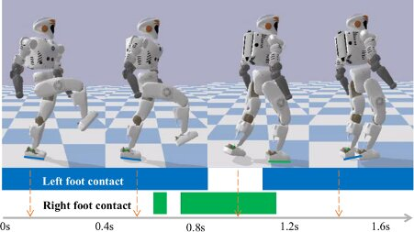
Concepts of Motion in Robotics with Examples
Locomotion Motion
Locomotion is the ability of a robot to move or change position/orientation relative to its environment.
Mechanisms of Locomotion
Wheels – Fast, efficient on flat surfaces
Tracks – Better for rough terrain and climbing
Legs – Walk, crawl, or jump on uneven terrain
Propellers – Enable aerial robots (e.g., drones) to fly and hover
Key Advantages
Enables mobility and flexibility across varied environments
Can combine with articulated or oscillatory motion for advanced tasks
Examples:
Wheel encoders for navigation
Force sensors for balance in legged robots

Slide 15
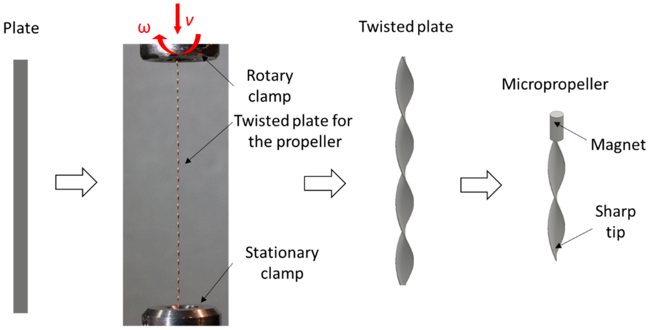
Concepts of Motion in Robotics with Examples
Helical Motion
It is type of motion where there is combination of both linear and rotational motion.
In this, robot moves along a linear path while rotating on its axis.
Its end effectors traces a screw like pattern.
This motion is achieved by lead screws, ball screws, or worm gears.
Advantages
It gives high degree of precision and accuracy.
Helical motion can perform complex tasks like robotic surgery or micro-manufacturing easily.
Examples:
Drilling, Milling, Cutting etc.
Machining , Manufacturing etc.

Slide 16
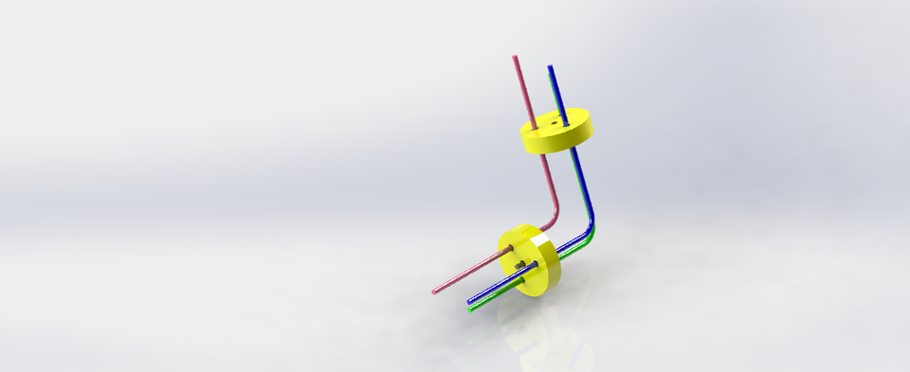
Concepts of Motion in Robotics with Examples
Perpendicular Motion
It is type of motion where a point moves at 90 degree with respect to the contact point.
In this, robot moves along in a direction that is perpendicular to a specific reference point or axis.r
Its end effectors traces a screw like pattern.
This motion is achieved by linear actuators, rotary actuators, servo motors etc.
Advantages
It gives high degree of precision and accuracy.
Helical motion can perform complex tasks like robotic surgery or micro-manufacturing easily.
Examples:
Drilling

Slide 17
Thanks For Joining
^_^

