Slide 1
Chapter 3:
Concepts in Robotics
Part - 1

Slide 2
Understanding the Concept of Robotics
In order to make robots work, there are some key components that are required:
Key Components: Motion, Joints, and Links
Manipulation: Enables robots to pick, move, or assemble objects (e.g., robotic arms).
Mobility: Allows robots to navigate environments (wheeled, legged robots).
Precision: Ensures high accuracy in tasks like microsurgery or electronics assembly.
Versatility: Multiple joints/links help switch tools for tasks like welding, painting.
Safety: Motion planning and sensors prevent collisions and ensure safe interaction.

Slide 3
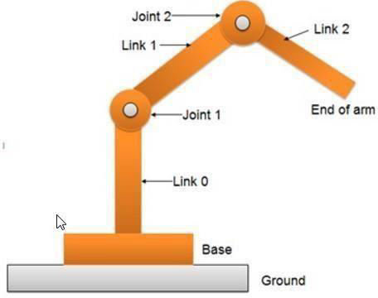
Understanding the Concept of Robotics

Slide 4
Concepts of Motion in Robotics with Examples
Linear Motion
What is Linear Motion?
Also called translational motion
Refers to movement in a straight line, not around an axis
Moves robot links or end effectors along a direct path
Examples
A robotic arm moving up and down
A wheeled robot moving forward/backward
A robot on a conveyor belt placing parts
How Is Linear Motion Achieved?
Prismatic Joints: Allow linear movement along one axis
Linear Actuators:
- Convert rotational motion into linear motion
- Use motors, gears, and rails
Sliding Mechanisms: Provide smooth linear displacement
Wheels or Tracks: Enable straight-line mobility in mobile robots

Slide 5
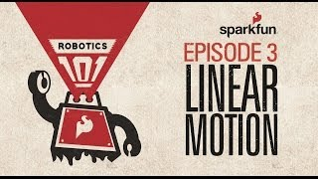
Linear Motion

Slide 6
Concepts of Motion in Robotics with Examples
Rotational Motion
What is Rotational Motion?
Also known as angular motion
Involves movement around a fixed point or axis
Common in robotic arms, wheels, joints, and cameras
Examples of Rotational Motion
Robotic arm rotating at a joint to change angle
Gripper rotating to grasp an object
Camera pivoting for inspection or surveillance
Robot rotating tools for welding or painting
How Is Rotational Motion Achieved?
Revolute Joints (Rotary Joints):
Allow rotation around one axis
Rotary Actuators:
Motors and gears generate rotation
Gears & Linkages:
Transfer rotational motion to different parts of the robot

Slide 7
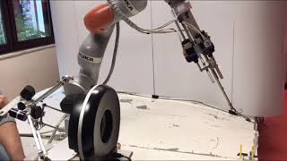
Rotational Motion

Slide 8
Concepts of Motion in Robotics with Examples
Reciprocating Motion
Definition
Reciprocating motion refers to the back-and-forth linear movement of a robotic component or mechanism.
It involves alternating motion between two fixed points along a straight path.
Examples of Reciprocating Motion
Assembly Lines – Repeated linear actions like pressing, cutting, or inserting.
Piston Engines – Convert combustion energy into rotational motion.
How It Works
Mechanisms Used:
  Slider-Crank Mechanism
  Converts rotational motion into linear reciprocating motion.
  Often involves a rotating crank connected to a linear slider

Slide 9
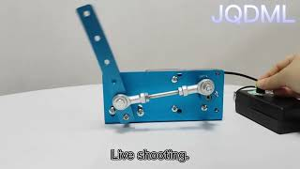
Reciprocating Motion

Slide 10
Concepts of Motion in Robotics with Examples
Translational Motion
What Is Translational Motion?
Movement of a robot or its parts along a straight line.
No rotation or pivoting—pure linear motion.
Example: Like a train on a track or car on a road.
Examples of Translational Motion
Medical Robotics: Deliver medication or perform linear surgical tasks.
Manufacturing: Move along a conveyor to pick/place parts.
How It’s Achieved
Prismatic Joints (Slider Joints)
Enable motion along a single axis.
Linear Actuators
Use motors/gears to move in one or multiple directions.

Slide 11
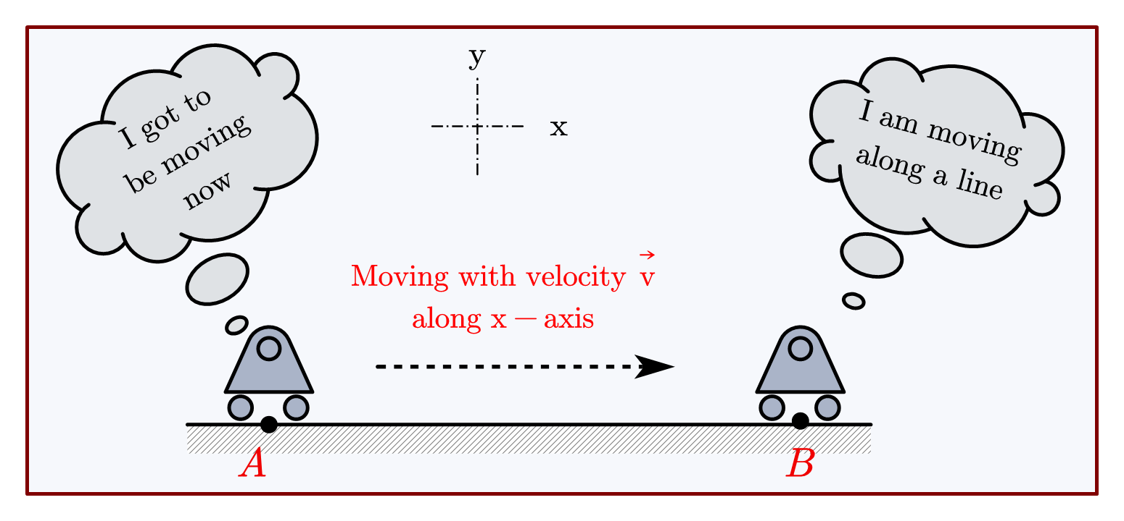
Translational Motion

Slide 12
Thanks For Joining
^_^

