Slide 1
Chapter 2:
Robot As A System
Part - 1

Slide 2
Introduction
In this chapter, we will discuss about Building Blocks of Robots and different types of it.
We will know about Microbots, Snakebots, Insect-Robots, Industrial Robots and many more.
The primary objective of this chapter is to provide you knowledge about working and types of robots in present world.

Slide 3
Introduction
Given
Task
Robot
Model
Error Signals
Controller
Actuators
Manipulators
Task
Done
x
Information Processing Unit
Sensors

Slide 4
Building Blocks of Robots
It has been broken down into these blocks:
Mechanical Block
Electronic Block
Computational Block

Slide 5
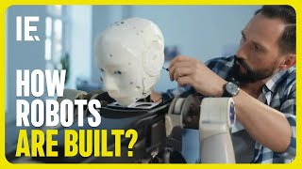
Building Blocks of Robots

Slide 6
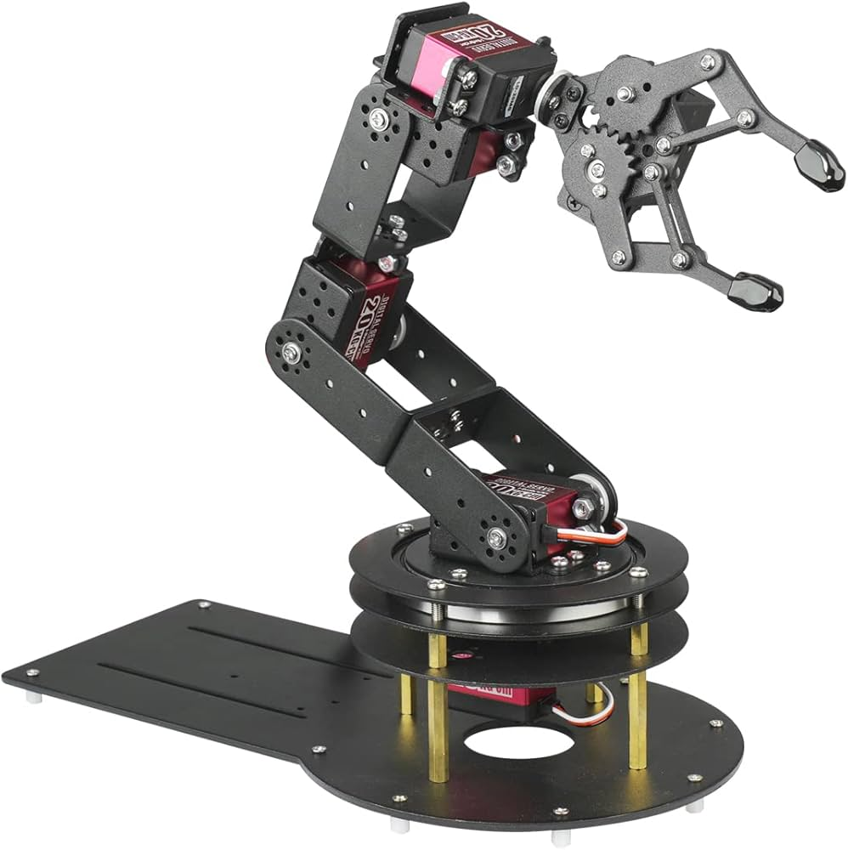
Mechanical Block
The mechanical block refers to the physical components of the robot, such as the body, actuators, and joints.
It provides the robot with its physical capabilities, enabling it to move and interact with its environment.
Consists of actuators (e.g., motors, hydraulic systems) that generate movement.
Joints connect components and allow flexibility in motion.
The design depends on factors like weight, size, and range of movement required by the robot.

Slide 7
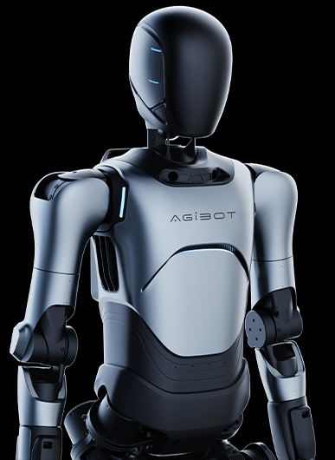
Mechanical Block
Humanoid robots: Require many actuators and joints for human-like movement and walking; complex coordination is needed.
Aerial robots (drones): Require lightweight, compact mechanical blocks with flying-capable actuators.
Underwater robots: Need waterproof, buoyant designs with actuators suited for movement in water.
Mobile ground robots: Use wheels or tracks for movement on different terrains; design focuses on traction and stability.

Slide 8
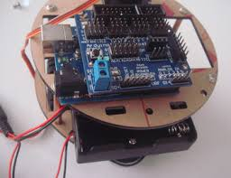
Electronic Block
Refers to the electronic components of the robot, such as sensors, microcontrollers, and other devices.
Enables the robot to perceive its environment and gather information.
Includes sensors like cameras, microphones, and lidars to detect visual, audio, or spatial data.
Contains the control system, which processes sensor data and sends commands to the actuators.

Slide 9
Electronic Block
Humanoid robots: Use cameras, microphones, and various other sensors to perceive and adapt to their environment.
Aerial robots: Employ cameras, lidars, GPS, and barometers for navigation, object detection, and altitude measurement.
Underwater robots: Use sonar, optical sensors, and pressure sensors to detect objects and measure depth/orientation.
Mobile robots: Use cameras, lidars, and other sensors to detect obstacles, navigate, and map the environment.

Slide 10
Computational Block
Refers to the software and algorithms that run on the robot's control system.
Provides the robot with the ability to process information, make decisions, and execute tasks.
Includes:
  Low-level control algorithms: Regulate actuator speed and position.
  High-level algorithms: Handle perception, decision-making, and planning.

Slide 11
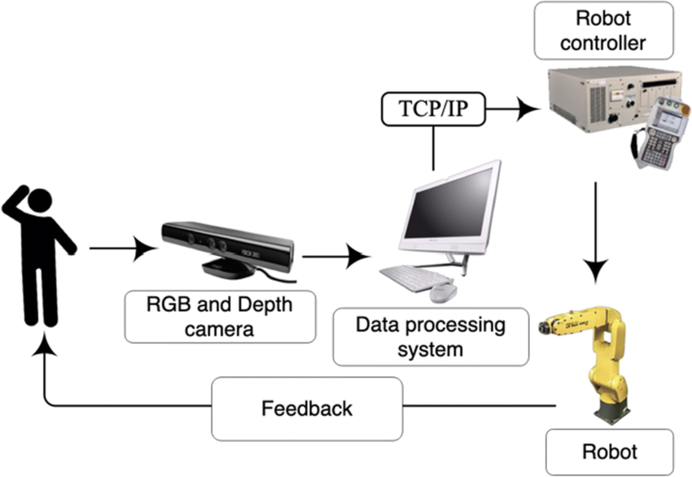
Computational Block

Slide 12
Computational Block
Humanoid robots:
Use algorithms for movement coordination, balance, and speech/gesture recognition.
Aerial robots:
Rely on flight control algorithms for altitude, stability, and navigation.
Perform tasks like target search or obstacle avoidance.
Underwater robots:
Use algorithms for navigation, object detection, mapping, and monitoring.

Slide 13
Computational Block
Mobile robots:
  Use algorithms for navigation, obstacle avoidance, target search, and path following.
The computational block works in tandem with the mechanical and electronic blocks.
This integration is essential for the robot to function effectively.
Designing a complete robot system requires understanding the interplay between all three blocks.

Slide 14
Identification of Robots
Demonstration: Observing a robot in action reveals its range of motion, dexterity, and intelligence.
Video: Offers a detailed view of the robot performing tasks like walking, flying, or problem-solving. Also, Visual representation of robot’s body and control systems.
Graphic Details: Reviewing technical specifications (size, weight, sensors, actuators, software) helps assess design and functionality.
Purpose-Based Identification: Recognizing a robot’s intended purpose (e.g., cleaning, manufacturing, humanoid interaction) aids in understanding its capabilities and limitations.

Slide 15
Thanks For Joining
^_^

