Slide 1
Chapter 1:
Introduction to Robotics
Part - 4

Slide 2
Ethics in Robotics
Overview:
Robots assist in dangerous, repetitive, and support tasks (e.g., hospitals, schools, elderly care).
Not all robotic applications raise ethical concerns, but some do, especially with advanced AI integration.
Major Ethical Fields:
Military Robotics: Weaponized drones and autonomous systems challenge human rights.
Bionics & Brain-Computer Interfaces: Blurs line between human and machine—raises identity and dignity concerns.
AI + Big Data Convergence: Mass data collection by robots could infringe on privacy and personal freedoms.
Future Outlook:
Consumer robots will become mainstream—customized via apps, sensors, and machine learning.
Robots will learn from environments, remember user profiles, and communicate autonomously with databases and each other.

Slide 3
Ethics in Robotics
Ethical Challenges:
Privacy & Data Security: Robots storing personal health, habits, routines
Bias & Discrimination: Algorithms may unknowingly perpetuate inequality
Key Ethical Questions:
Should robots be programmed to follow a code of ethics?
Can ethics be encoded, and who decides what’s ethical?
Call to Action:
Ethical responsibility lies not in robots, but in humans who design and deploy them.
A global consensus on roboethics is needed to avoid misuse.

Slide 4
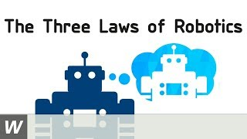
Laws of Robotics
There are three laws given by Isaac Asimov, a sci-fi writer:
A robot may not injure a human being or, through inaction, allow a human being to come to harm.
A robot must obey the orders given to it by human beings, except where such orders would conflict with the First Law.
A robot must protect its own existence as long as such protection does not conflict with the First or Second

Slide 5
Activity
Visit the below link to make a robot:
https://www.abcya.com/games/make_a_robot

Slide 6
Categorisation of Robots
There are two main categories under which it has been divided:
Fixed Robots
Mobile Robots
Fixed Robots
Definition: Fixed robots are stationary robotic systems that are permanently installed in a specific location and perform repetitive or pre-programmed tasks.
Key Characteristics:
Non-mobile: Cannot move from one location to another
Highly accurate and efficient in performing specific tasks
Mobile Robots
Definition: Mobile robots are autonomous or semi-autonomous machines capable of moving through their environment to perform tasks.
Key Characteristics:
Equipped with wheels, tracks, or legs for mobility
Use sensors, cameras, LIDAR, and GPS for navigation and obstacle avoidance

Slide 7
Classification of Robots
There are classified into these:
Based on Field/Terrain
Based on Form
Based on Functions
Based on Control
Based on Work
Bio-inspired Robots

Slide 8
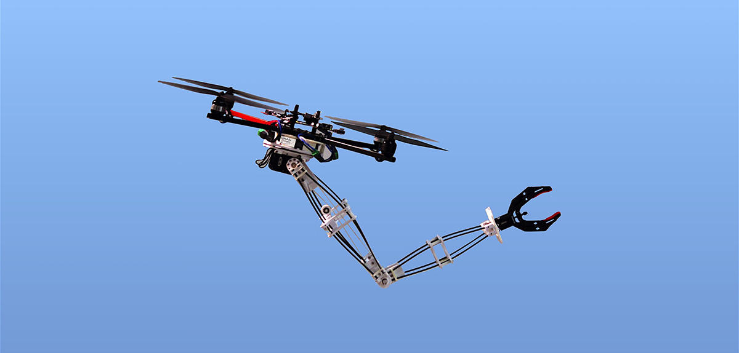
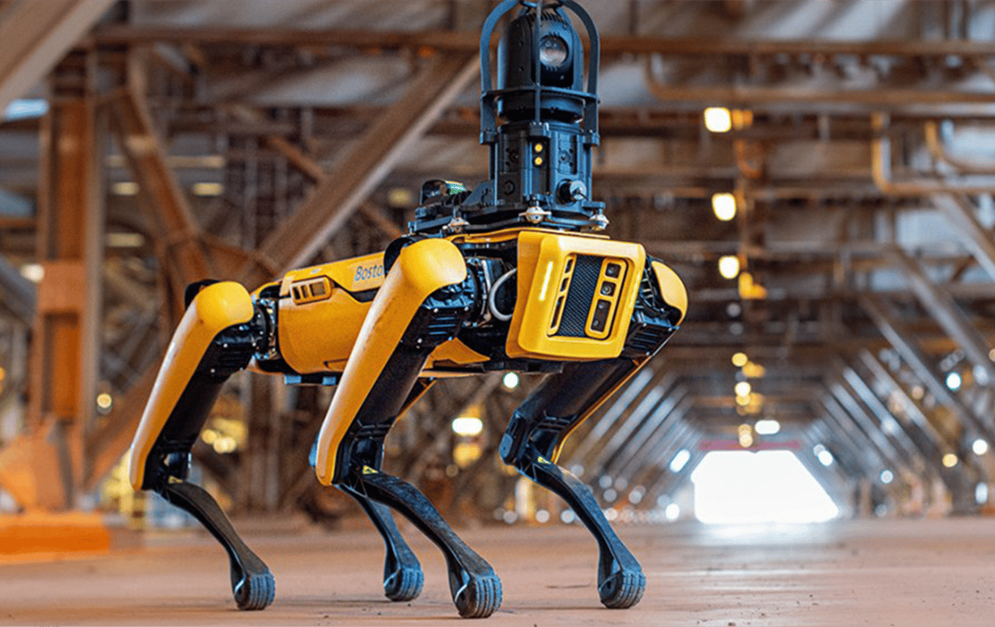
Based on Field/Terrain
Aerial Robots
Those type of robots that can operate in air for a period of time.
There are different varieties like multi-copter drones, autonomous flying vehicles, unmanned aerial vehicles etc.
These are used for surveillance, aerial photography, carrying packages etc.
Ground Robots
Those type of robots that works on ground.
Examples are UGV (Unmanned Ground Vehicles), mobile robots etc.
Wheels, motors, chassis etc are main components of Ground Robots.

Slide 9
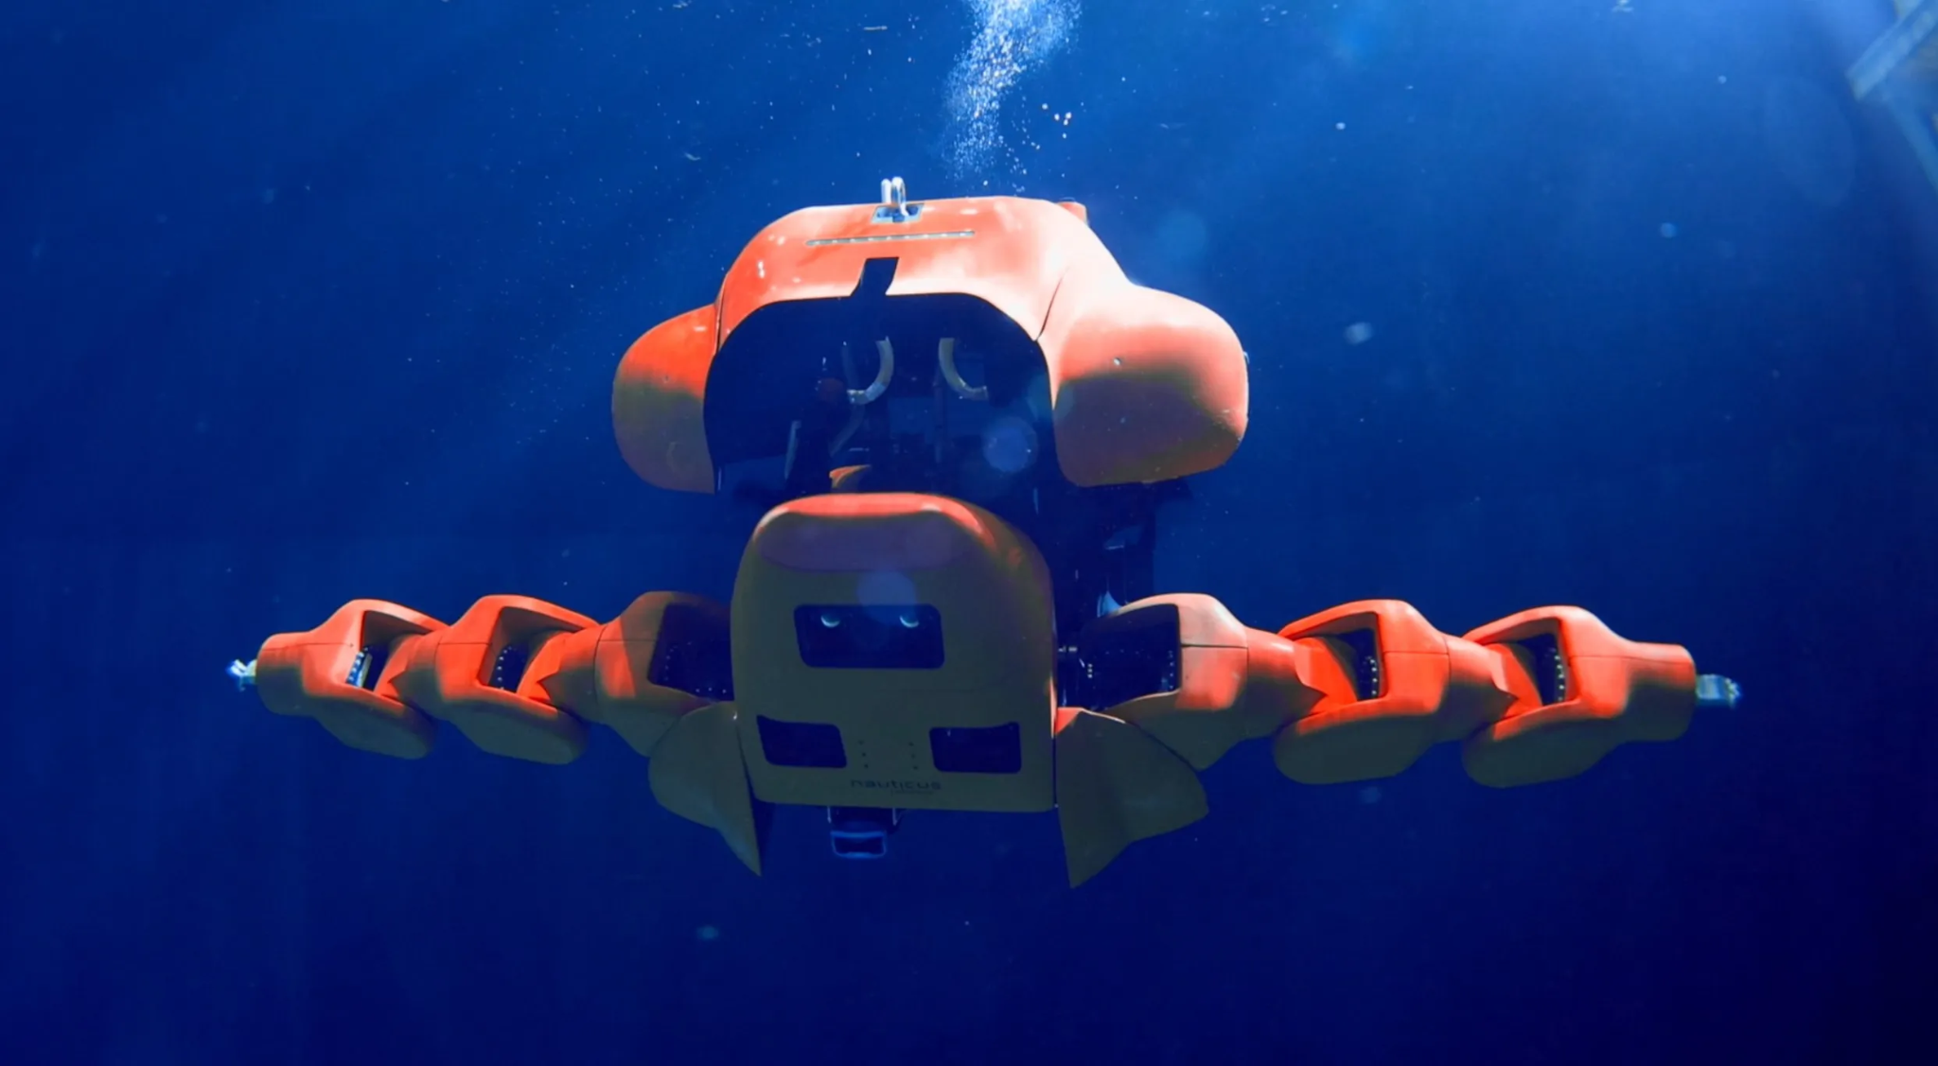
Based on Field/Terrain
Underwater Robots
Those type of robots that can operate underwater or overwater sometimes
Different types of these robots are Remotely Operated Vehicles (ROVs), Autonomous Underwater Vehicles (AUVs), Submersible Robotic Vehicles etc.

Slide 10
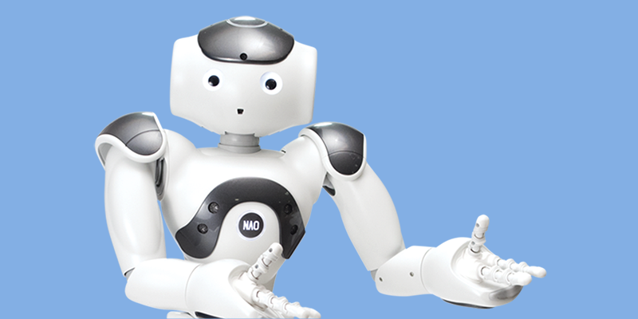
Based on Form
Anthropomorphic Robots
These robots are designed to resemble the human form.
Example: Humanoid robots like Honda's ASIMO or Sophia by Hanson Robotics.
Animal-Like Robots
Inspired by animals, these robots mimic the movement and behavior of specific creatures
Example: Boston Dynamics’ robotic dog "Spot"

Slide 11
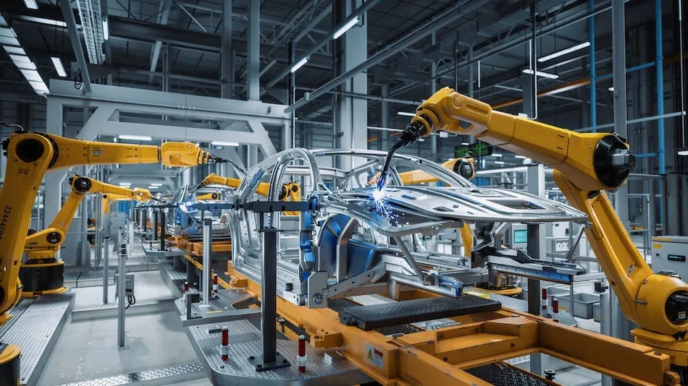
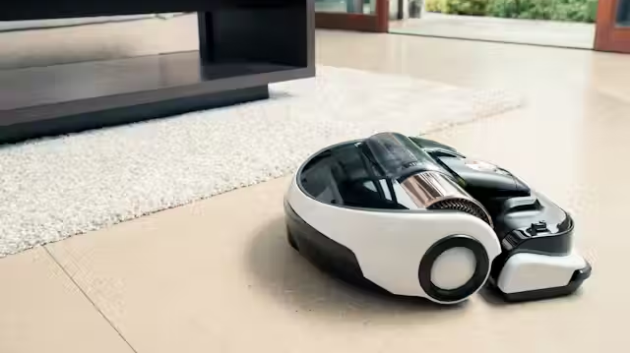
Based on Form
Industrial Robots
These are robotic arms or systems used primarily in manufacturing and assembly lines.
Example: Robotic arms used in automotive factories (e.g., ABB, KUKA robots).
Domestic Robots
These robots are designed for home use to assist with daily tasks.
Example: Robotic vacuum cleaners (like Roomba), home assistant robots, or robotic lawn mowers.

Slide 12
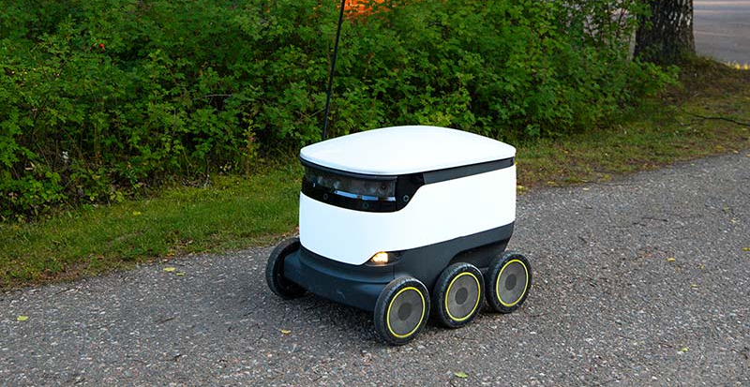
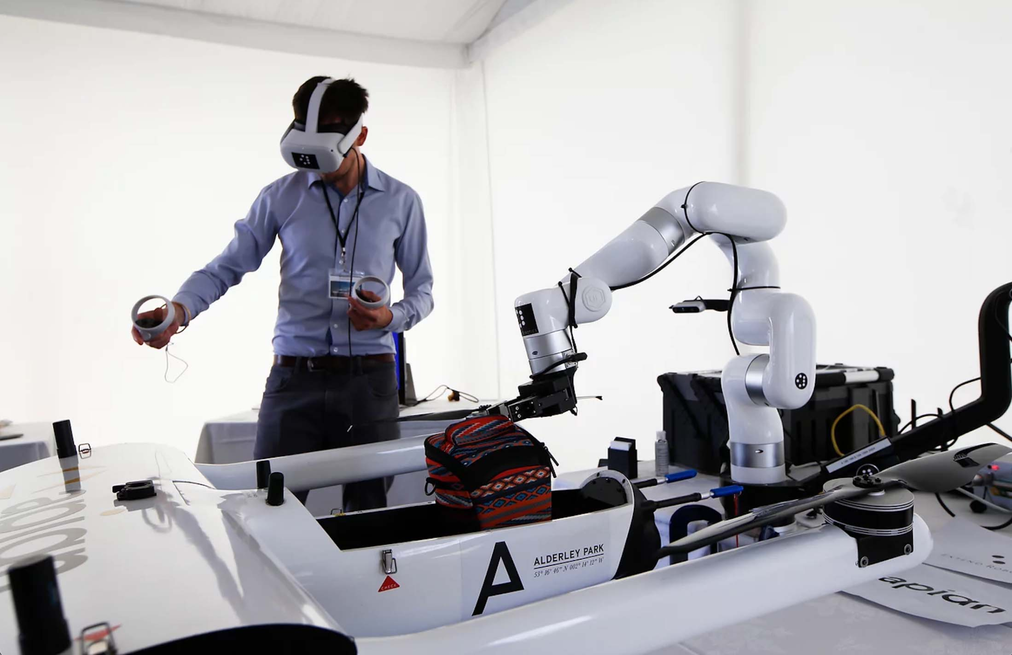
Based on Control
Autonomous Robots
These robots can make decisions, adapt to their environment, and perform tasks without direct human input.
Example: Self-driving cars, robotic vacuum cleaners, and warehouse robots.
Teleoperated Robots
These robots are controlled remotely by a human operator.
Example: Robotic arms used in space exploration, underwater drones, or bomb disposal robots.

Slide 13
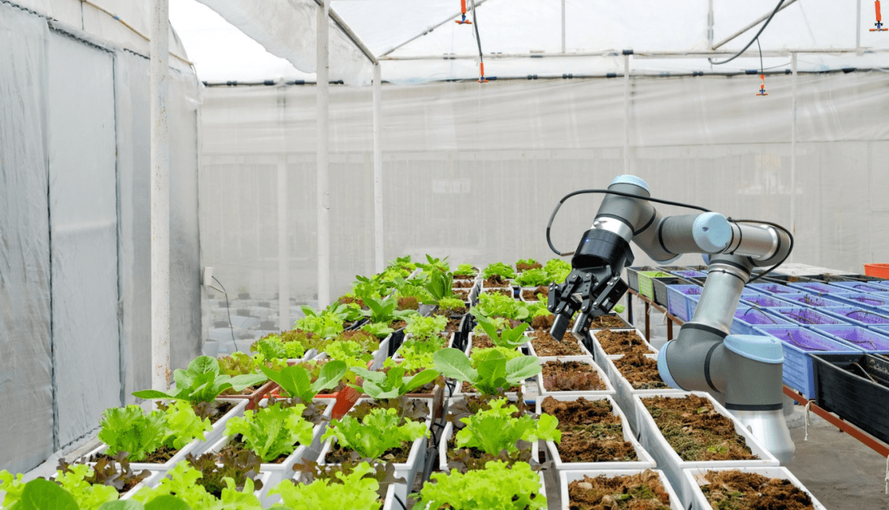
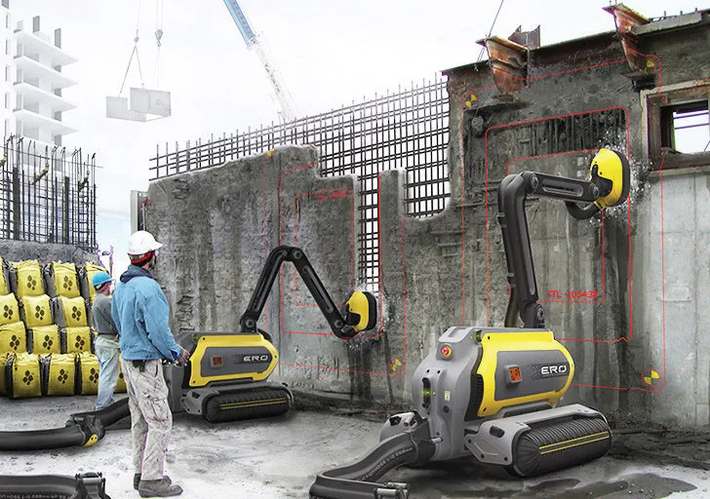
Based on Work
Agricultural Robots
These robots are designed to automate farming tasks like planting, harvesting, spraying, and monitoring crops.
Example: Harvesting robots, autonomous tractors, and weed control robots.
Construction Robots
These are used in building and infrastructure projects to assist with tasks such as bricklaying, concrete pouring, demolition, and inspection.
Example: Robotic bricklayers or drones for site surveying.

Slide 14
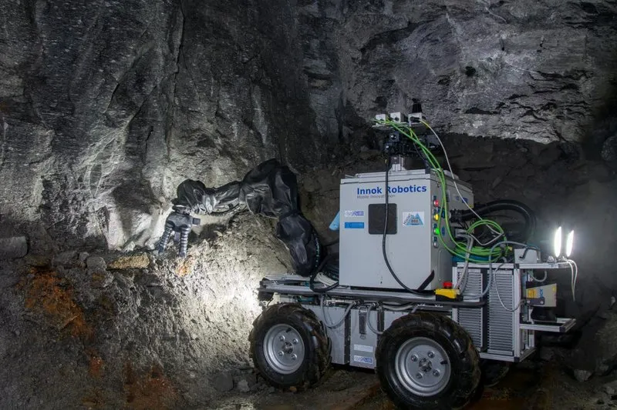
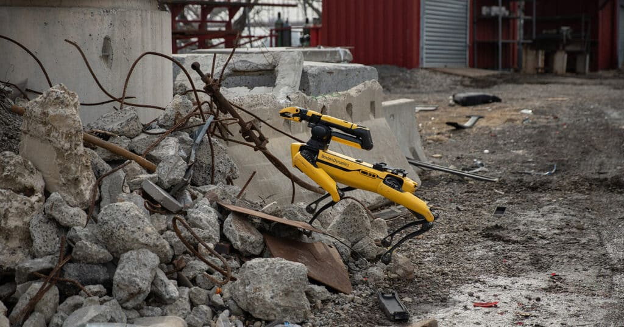
Based on Work
Mining Robots
Mining Robots operate in hazardous underground environments to extract minerals, monitor tunnels, and handle explosives.
Example: Autonomous drilling machines and robotic loaders.
Search and Rescue Robots
These robots are deployed in disaster zones to locate and assist victims in hard-to-reach or dangerous areas.
Example: Snake-like robots, aerial drones, or robots with thermal imaging.

Slide 15

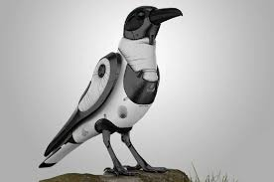
Bio-Inspired Robots
Humanoid Robots
Modeled after the human body, these robots often have a head, torso, arms, and legs.
Example: ASIMO by Honda, Sophia by Hanson Robotics.
Bird-Inspired Robots
These robots imitate the flight and movement of birds, often used for surveillance, environmental monitoring, or flying research.
Example: Robotic birds with flapping wings used in aerial reconnaissance.

Slide 16
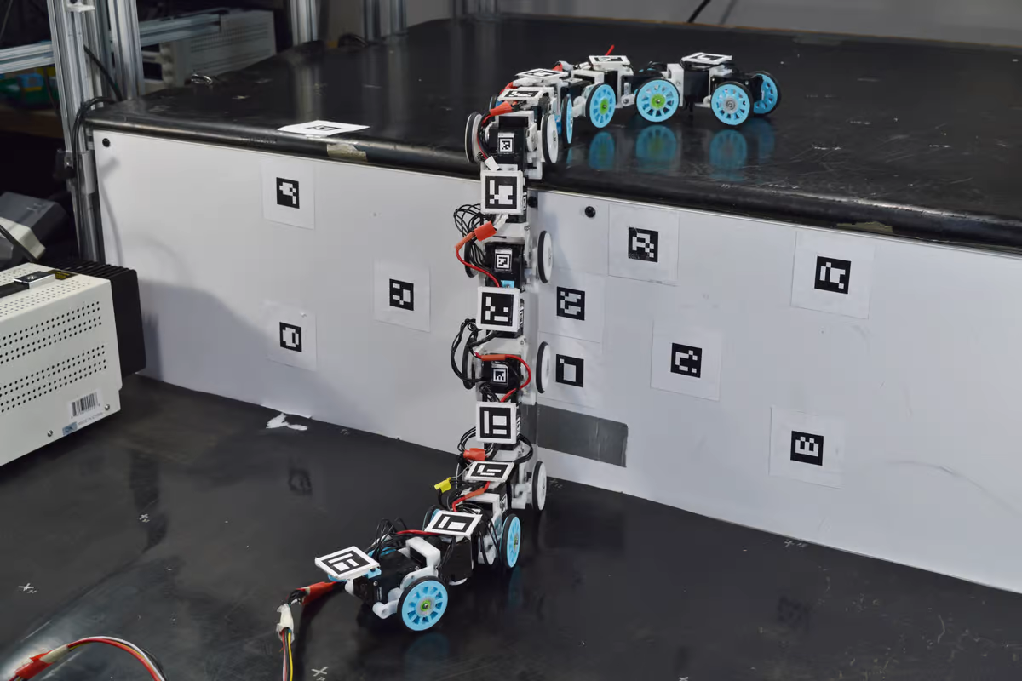
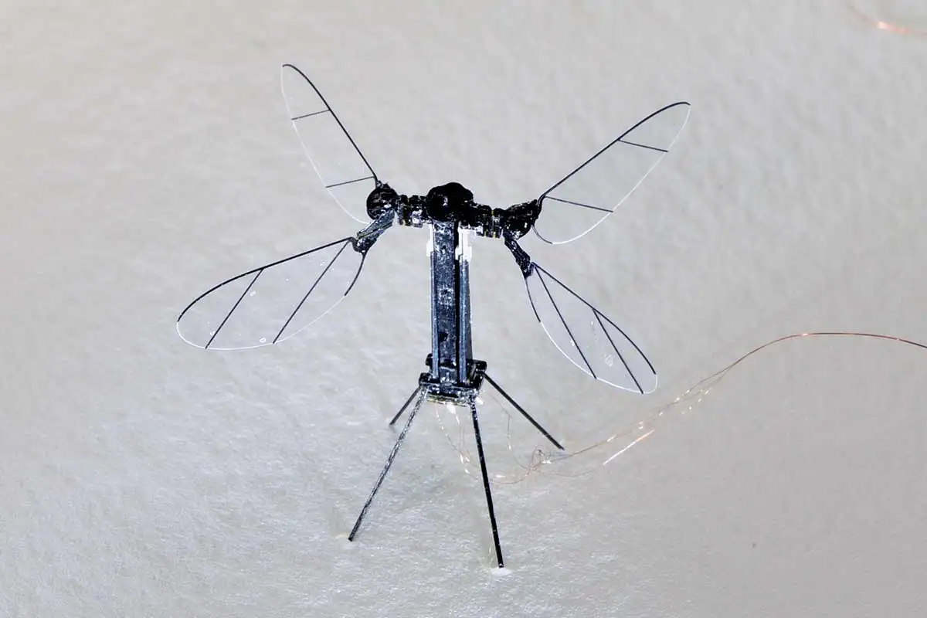
Bio-Inspired Robots
Snake-Inspired Robots
Mining Robots operate in hazardous underground environments to extract minerals, monitor tunnels, and handle explosives.
Example: Autonomous drilling machines and robotic loaders.
Insect-Inspired Robots
These robots are deployed in disaster zones to locate and assist victims in hard-to-reach or dangerous areas.
Example: Snake-like robots, aerial drones, or robots with thermal imaging.

Slide 17
Future of Robotics and Robots
Impact, Challenges & Outlook
1. Smarter Robots with AI & ML Integration
Ongoing advancements in Artificial Intelligence and Machine Learning are enabling robots to move beyond repetitive tasks.
Robots are evolving into intelligent collaborators capable of cognitive functions such as problem-solving, learning, and decision-making.
2. Expansion into More Life & Work Domains
Sophisticated robots will increasingly be integrated into everyday life — from homes and hospitals to warehouses and offices.
These robots will work with humans, not replace them, augmenting human capabilities.
3. New Jobs and Upskilling Opportunities
While some traditional roles may decline (e.g., manual welding in factories), new roles will emerge:
➤ Robot programmers
➤ Maintenance and repair technicians
➤ Automation specialists
Companies may offer in-house training, empowering workers with valuable technical skills.

Slide 18
Future of Robotics and Robots
Advancements & Opportunities
1. Economic Growth and Productivity Boost
Robots will contribute to greater productivity, optimized workflows, and global economic growth.
They will perform high-precision, time-consuming tasks, improving efficiency across industries.
2. Job Automation Concerns
Studies suggest:
➤ Up to 20 million manufacturing jobs could be lost by 2030.
➤ Nearly 30% of all jobs may be automated.
Raises the need for proactive workforce planning and education reform.
3. Human Empowerment Through Automation
Robots will take over burdensome, repetitive tasks, enabling humans to focus on innovation, education, and self-improvement.
Applications include:
➤ Efficient transportation systems
➤ Enhanced healthcare support
➤ Smart logistics and services

Slide 19
Thanks For Joining
^_^

