Slide 1
Chapter 1:
Introduction to Robotics
Part - 3

Slide 2
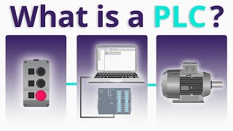
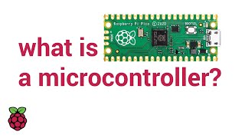
Controllers
Definition:
Controllers are the central processing units of a robot that receive data from sensors, process that information, and send commands to actuators.
Functionality:
Controllers are used to program in order to provide large number of tasks.
Importance in Robotics:
It is crucial for real-time decision making and enabling autonomy.
Common Types:
MCU, Microcontrollers
SBCs, Single Board Computers
PLC, Programmable Logic Controllers

Slide 3
Power Source
Definition
Power Source refers to the component or system that provides the necessary energy for a robot to operate.
It supplies power to all robotic components, including controllers, sensors, actuators, and communication systems.
Common Types:
Batteries
Solar Cells
Direct Power Supply

Slide 4
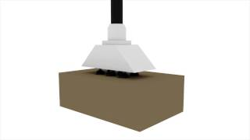
End Effectors
Definition
End Effectors are the devices or tools attached to the end of a robotic arm that interact with the environment to perform specific tasks.
They can vary depending on the application and include grippers, welding torches, suction cups, or specialized tools for painting, cutting, or assembling.
Common Types:
Grippers
Tools
Sensor Tips

Slide 5
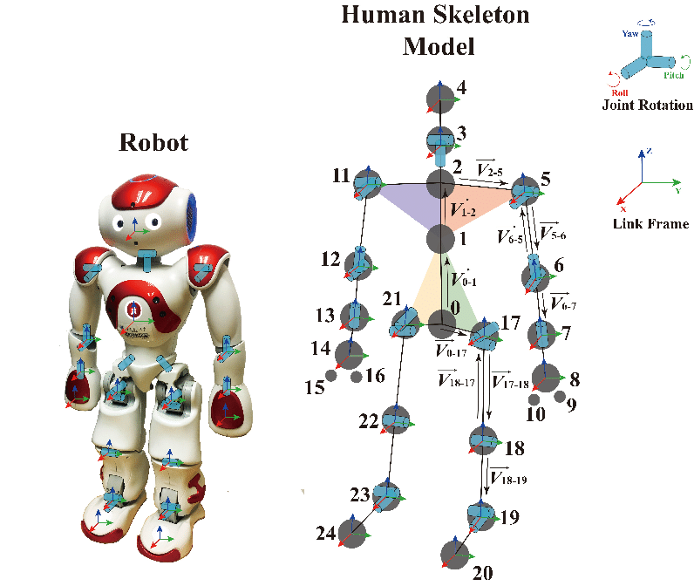
Frames and Structures
Frames:
Frame refers to the fixed or reference coordinate system used to define the position and orientation of different parts of a robot
It provides a spatial reference that helps in controlling movements and ensuring accuracy in tasks.
Structures:
Structure is the physical framework or body of the robot that supports all its components, such as actuators, sensors, and controllers
It determines the robot’s strength, stability, and range of motion, and is usually made of materials like metal, plastic, or composites.

Slide 6
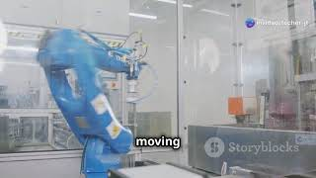
Control Interfaces
Control Interfaces are the systems or tools through which humans or other systems communicate with and operate a robot.
They enable the user to send commands, receive feedback, and monitor the robot’s status.
Control interfaces can include physical devices like joysticks, touchscreens, keyboards, or software-based interfaces such as graphical user interfaces (GUIs), remote control systems, and programming environments.

Slide 7
Generations of Robots
According to Maus in 1986, there are four generations of robots:
First Generation Robots
Primitive operating machines
Very limited movement
Used for pick-and-place tasks in engineering
Some are still in use today
Second Generation Robots
Programmed using a button box
Tasks recorded on magnetic tape
Played back for the robot to "learn" and repeat
Commonly used for spot welding and spray painting (e.g., in the automobile industry)

Slide 8
Generations of Robots
Third Generation Robots
Computer-programmable, connected directly to computers
Became commercially available in 1981
Very limited sensing capabilities
Operate with impenetrable coordinate systems
Can “see” in 2D, no depth perception
Fourth Generation Robots (In Development)
Include arms, legs, jigs, and feelers working in sync
Greatly improved tactile sensitivity
Equipped with Artificial Intelligence (AI):
  Enables self-programming
  Supports decision-making & problem-solving

Slide 9
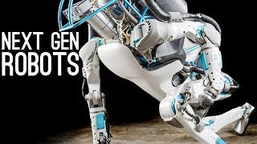
Generations of Robots

Slide 10
History of Robots
Early 1900s
First time robots were used in industry.
Robots were used by Ford.
It was used in conveyor belt assembly line.
1940s
During this era, robots were designed to operate without humans
Radar systems and guided missiles were developed for the World War II
In this time, robots were primarily used in war equipments.

Slide 11
History of Robots
1950s
Human machine interaction research started
Robotics was defined as science and technology
of robots
First industrial robots were developed by George
Devol and Joseph Engelberger in Unimation Inc.
1960s
Rise of numerical control machines and teleoperators
Computer advancements led to more intelligent robots
This time led to rapid development of capable robots

Slide 12
History of Robots
1970s
Integrated circuits and digital computers
transformed robotics
Robots became key in automated manufacturing
Used for specific tasks like welding and painting
1980s
Introduction of:
  Sensors (vision, force, touch)
  Actuators for movement
  Control architectures for decision-making
Microcontrollers and computer vision enabled robots to:
  Perform complex tasks
  Handle and sort objects intelligently

Slide 13
History of Robots
1990s
Focus on safety, fatigue reduction, and quality of life
Robots used in:
Hazardous environments
Search and rescue
Underwater, space, and medical fields
Robotics expanded with the Internet
2000s
Enabled by
Progress in AI and autonomy
Rise of:
Humanoid robots
Autonomous robots
Personal assistants

Slide 14
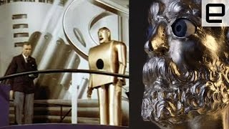
History of Robots

Slide 15
Thanks For Joining
^_^

