Slide 1
Chapter 1:
Introduction to Robotics
Part - 2

Slide 2
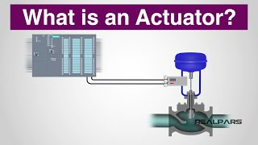
Actuators
Definition:
Actuators are devices that make robots move — often called the "muscles" of a robot.
They perform actions such as rotating joints or moving limbs.
Functionality:
Typically coupled to robot links via gear trains, which help reduce joint coupling.
Importance in Robotics:
Actuators enable robots to perform tasks by creating motion or force.
Common Types:
Motors
Hydraulic cylinders
Pneumatic cylinders

Slide 3
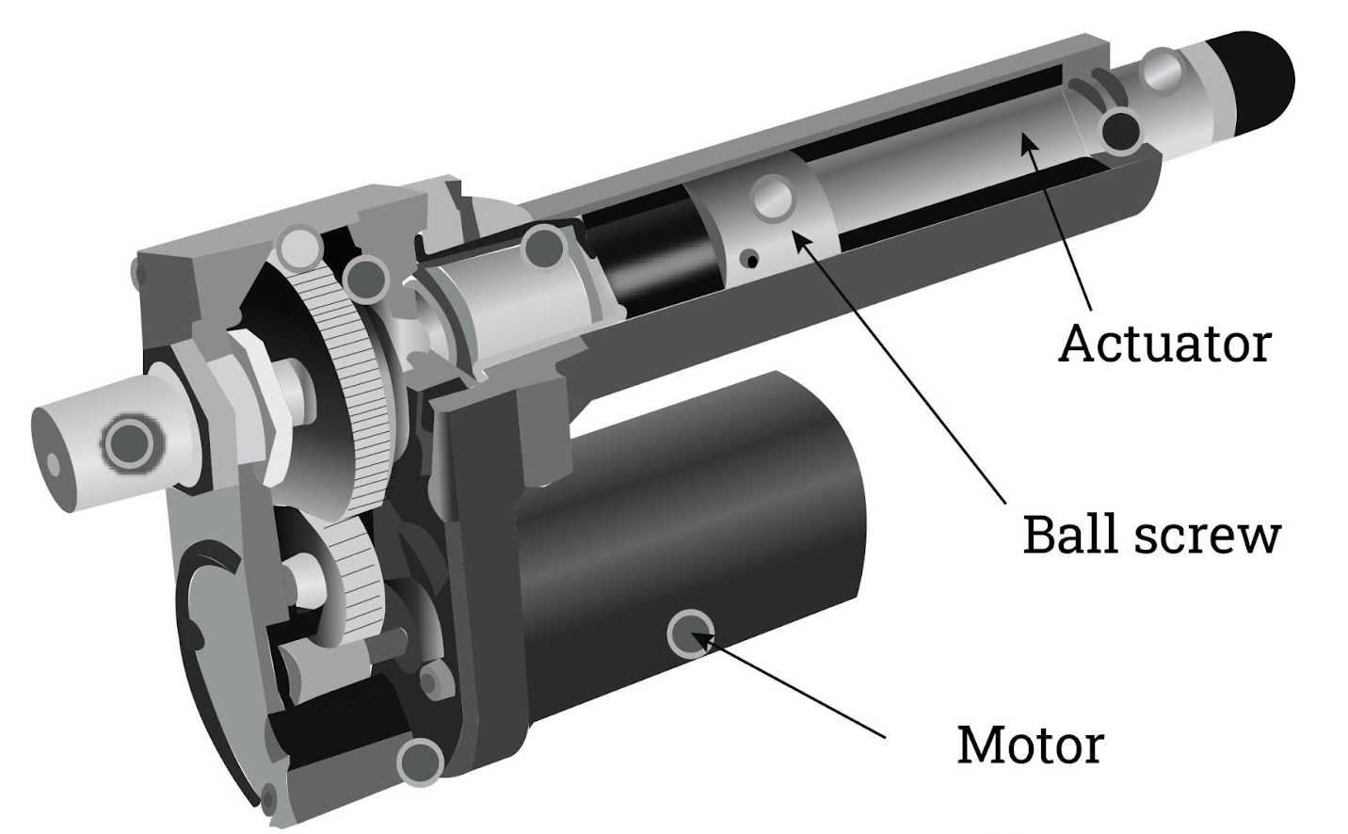
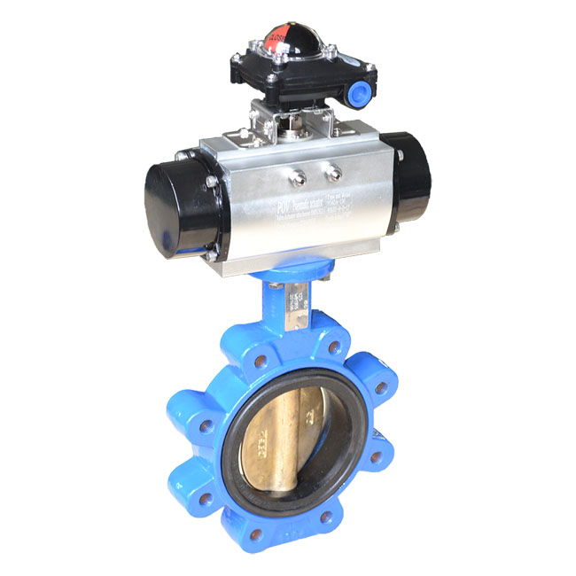
Actuators
Electric Actuators:
These type of actuators perform a rotational motion or a linear
motion with the help of an electric motors.
Different types of motors can be involved like Stepper Motors,
Servo Motors, Geared Motors etc.
Pneumatic Actuators:
These type of actuators use compressed air to do linear or rotary motion.
These are ideal for high speed and force applications.

Slide 4
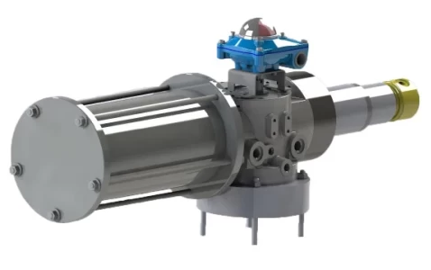
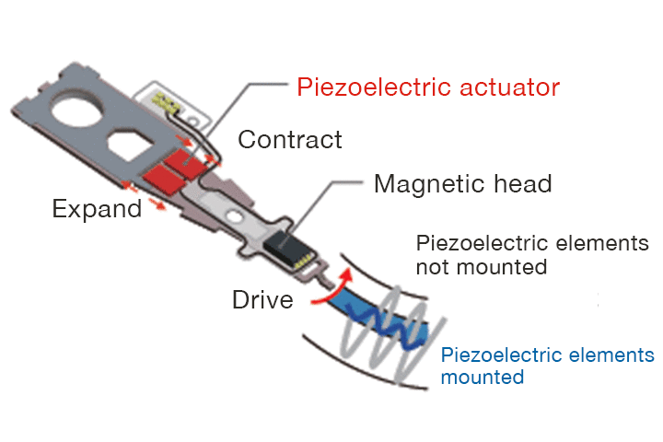
Actuators
Hydraulic Actuators:
These type of actuators have some kind of fluid in them which is compressed or decompressed according to the need.
It is used in lifting or moving heavy loads with precision.
Piezoelectric Actuators:
These type of actuators which uses materials that changes shape according to the power supply or electric field provided.
These are used in nano robotics or micro robotics.

Slide 5
Actuators
Shape Memory Alloy Actuators
SMA actuators use special alloys that "remember" and return to a pre-defined shape when heated.
These are made from materials like Nickel-Titanium (NiTi).
When deformed at lower temperatures, they revert to their original shape when heated — creating motion.

Slide 6
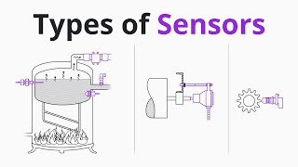
Sensors
Definition:
Sensors are devices that allow robots to perceive their environment and internal states, enabling intelligent decision-making and interaction.
Functions of Sensors:
Detect position, orientation, and motion
Sense obstacles and surroundings
Monitor internal conditions like temperature or joint angles
Provide feedback for control systems

Slide 7
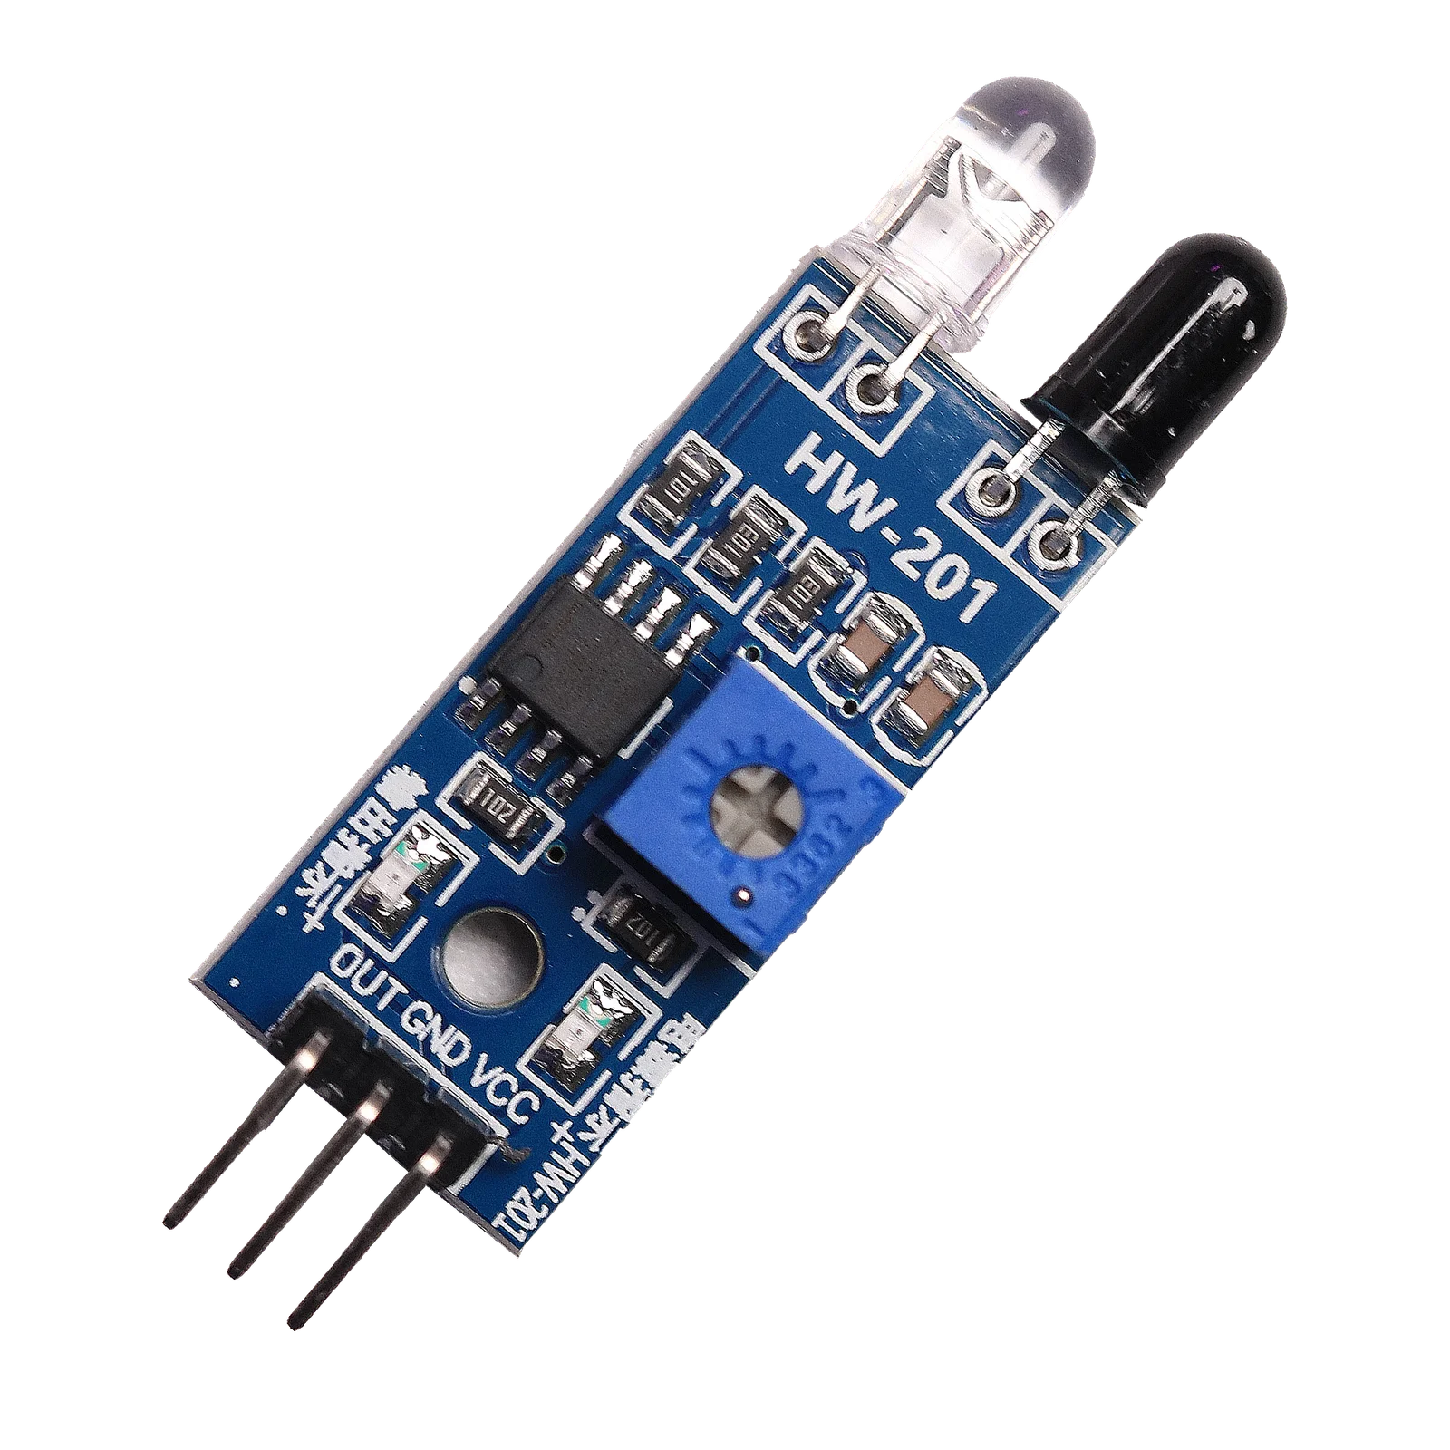
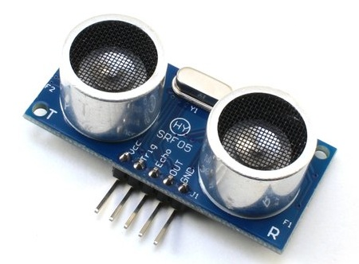
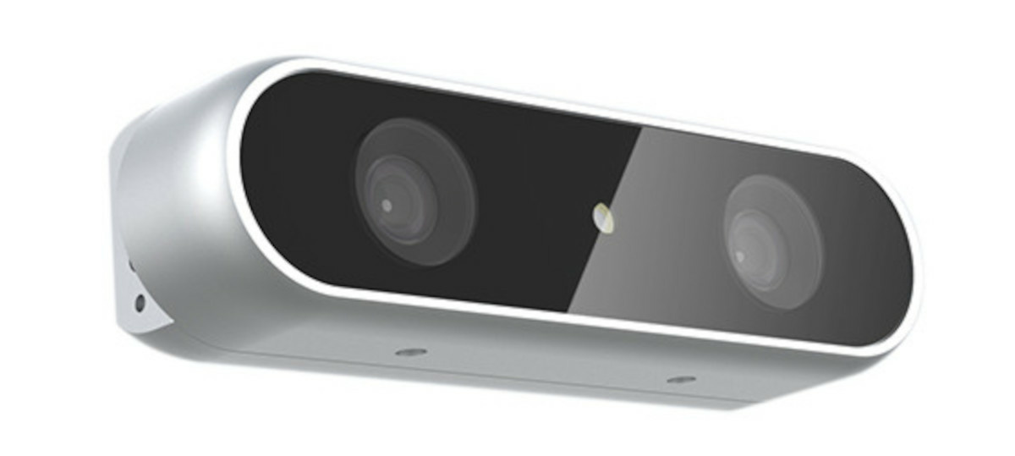
Sensors
Proximity Sensors:
These sensors can detect presence of any movement nearby object or body.
Most common are: Infrared Sensors, Ultrasonic Sensors etc.
Vision Sensors:
These type sensors uses camera or other types of image capturing device.
These sensors can do object detection, tracking and navigation.

Slide 8
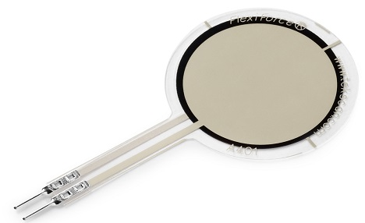
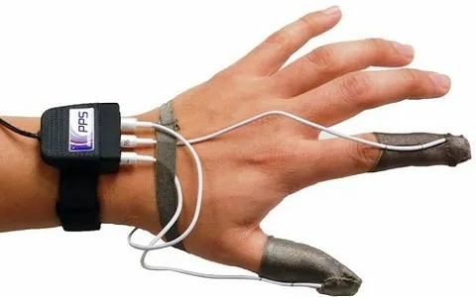
Sensors
Force/Torque Sensors:
These sensors can detect the amount of force being applied to the a subject part of a robot
These are very useful in knowing weight of objects while lifting it
Tactile Sensors:
Tactile Sensors are used for knowing texture, hardness and shape of a object by a touch or contact.
While gripping on a object, these are used.

Slide 9
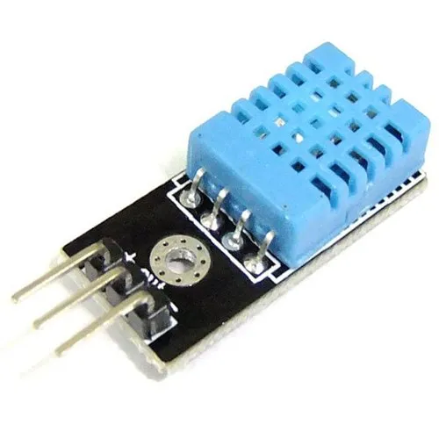
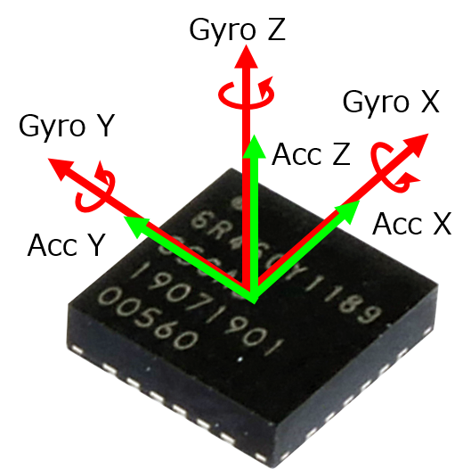
Sensors
Temperature Sensors:
In order to know the temperature of the surrounding or an object, these sensors are used.
Temperature sensors are interfaced with controllers to control the a specific task.
Inertial Sensors:
These sensors measure the acceleration, velocity and orientation of an object.
These are also called IMUs, Inertial Measurement Unit.
It is used for correcting path of a moving object.

Slide 10
Thanks For Joining
^_^

