Slide 1
Chapter 1:
Introduction to Robotics
Part - 1

Slide 2
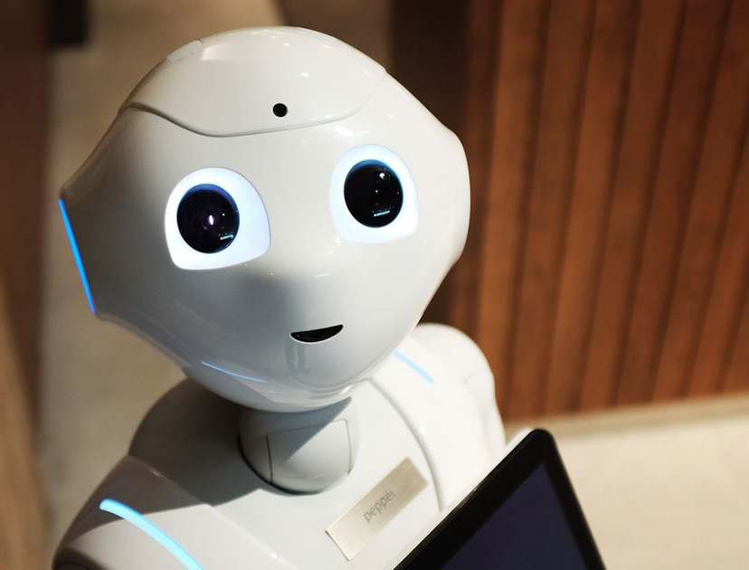
Understanding Robotics
According to National Robotics Association, “a robot is a re-programmable and multi-functional manipulator, devised for the transport of materials, parts tools, or specified systems, with varied and programmed movements, with the aim of carrying out varied tasks”
In other words, a robot is a versatile and re-programmable machine designed to handle materials, tools, or specific systems.
It performs a range of tasks using controlled and programmed movements.
Facts
In 1940, Isaac Asimov coined the term “Robotics”. He was Sci-Fi writer.
“Robot” term was first used by Capek in 1917 in his play “Opilec” and this
word comes from Czech word “robota”

Slide 3
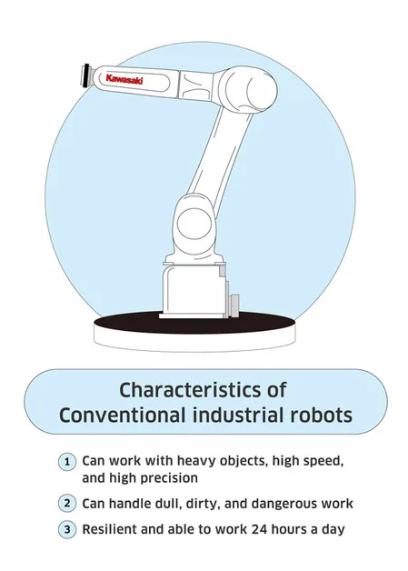
Characteristics of Robots
Automation: Operate with minimal human input.
Repetition: Perform tasks with high precision and consistency.
Speed: Work faster than humans, boosting efficiency.
Strength: Handle heavy or hazardous tasks safely.
Adaptability: Adjust to different tasks and environments.
Intelligence: Learn and make decisions using AI.
Interactivity: Respond to humans and surroundings via sensors and
control systems.
Robots combine these features to serve a wide range of applications across industries.

Slide 4
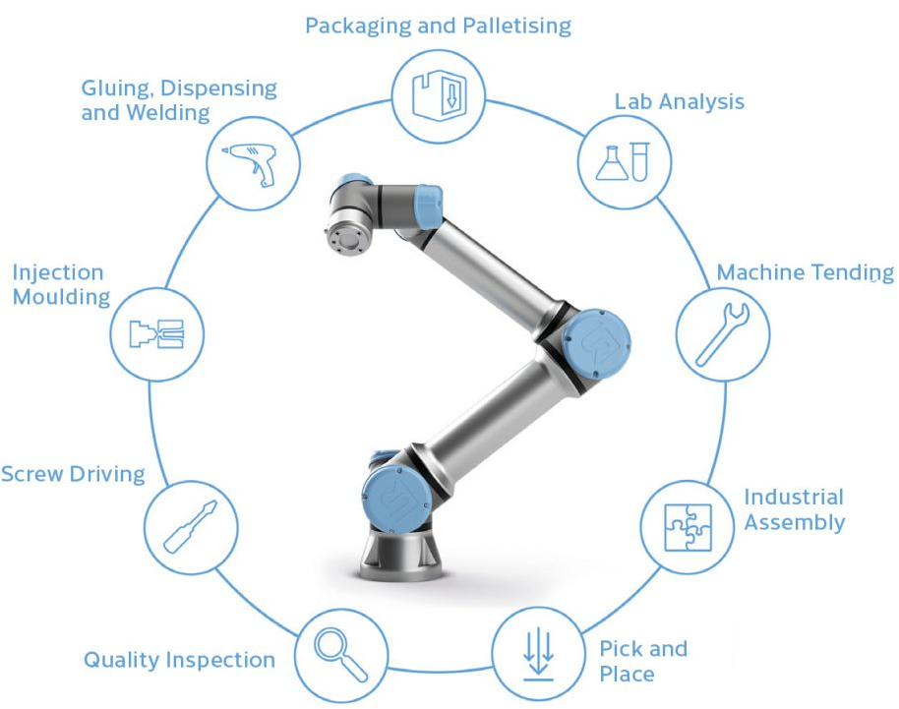
Benefits of using Robots
Enhanced Efficiency: Faster, more accurate task execution.
Safety: Operate in hazardous environments, reducing human risk.
24/7 Operation: Continuous work without downtime.
Consistency: High precision and reliable quality.
Cost-Effective: Lower labor costs and increased profitability.
Flexibility: Adaptable to various tasks and environments.
Customization: Tailored solutions for specific needs.
Workplace Improvement: Relieves employees from undesirable tasks

Slide 5
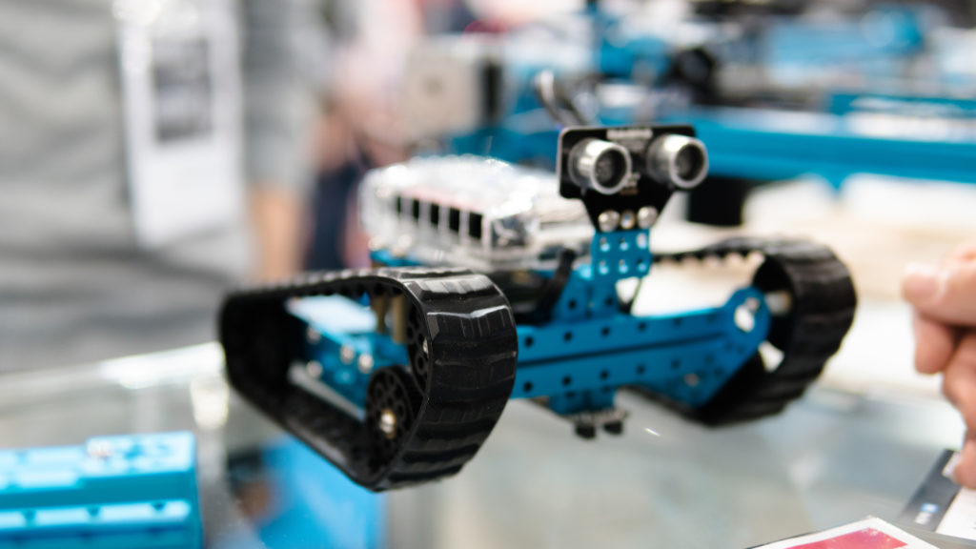
Limitations of Robots
Limited Creativity: Cannot replicate human imagination.
Programming Dependence: Restricted to pre-set instructions.
High Costs: Expensive to manufacture, program, and maintain.
Mobility Constraints: Less flexible in movement compared to humans.
Lack of Empathy: Inability to interact emotionally.
Power Reliance: Requires a consistent power supply.
Ethical Issues: Raises concerns about accountability and decision-making.

Slide 6
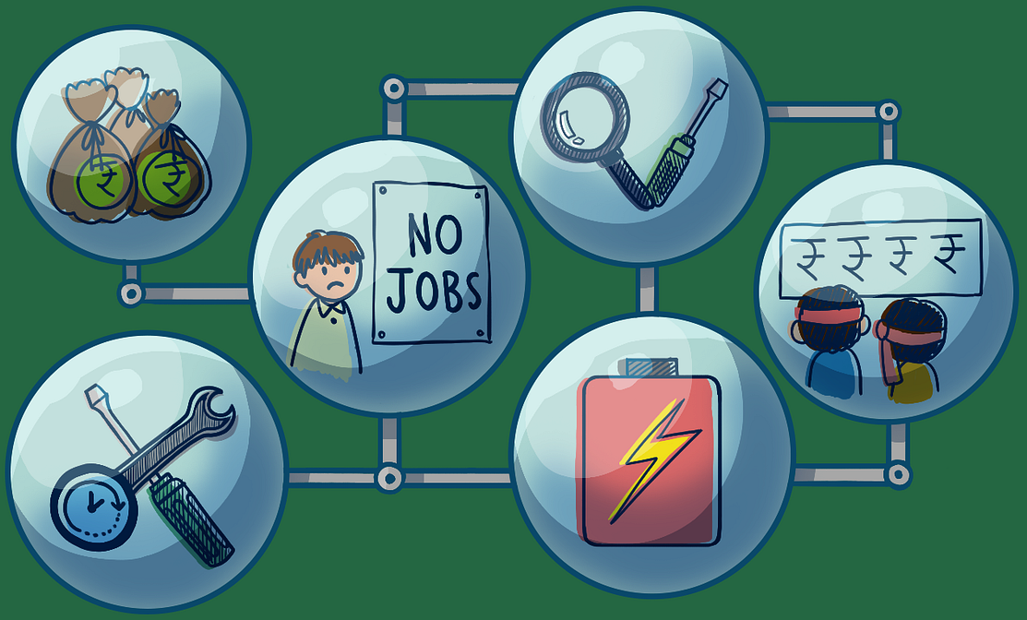
Disadvantages of Robots
High Initial Costs: Significant investment required for implementation.
Job Displacement: Potential reduction in certain manual jobs.
Skilled Support Needed: Requires hiring specialized programmers
and maintenance staff.
Integration Challenges: Difficult to integrate with existing systems.
Technical Vulnerabilities: Prone to malfunctions and cybersecurity risks.

Slide 7
Components of Robots
Actuators
Control Interfaces
Sensors
Frames and Structures
Controllers
End Effectors
Power Sources

Slide 8
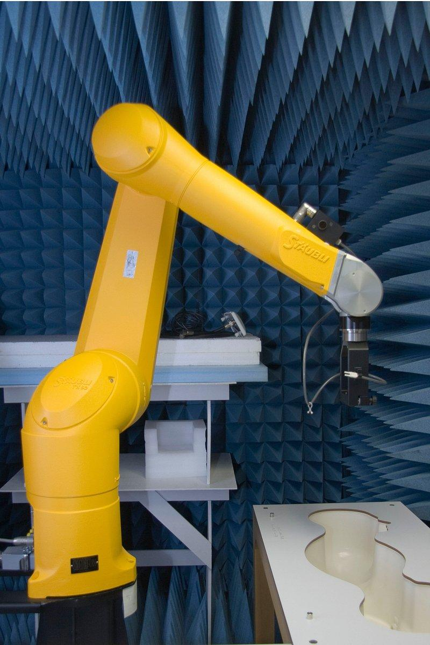
Components of Robots
Environment
External Sensors
Internal Sensors
Programming
Control Unit
Actuators
Mechanical Structure
User
Industrial Robot

Slide 9
Thanks For Joining
^_^

