Slide 1
Chapter 3:
Introduction to Data and Programming with Python
Part - 1

Slide 2
Familiarisation with Python
About Python
Developed by Guido van Rossum in 1991
Named after “Monty Python's Flying Circus”
General-purpose, object-oriented, high-level, and easy-to-learn language
Key Features of Python
🧠 High-Level & Easy to Learn: English-like syntax, beginner-friendly
💡 Expressive: Fewer lines of code for complex tasks
🔓 Free & Open Source: Downloadable from python.org
💻 Cross-Platform: Runs on Windows, Linux, macOS, Raspberry Pi
🧾 Interpreted: Executes code line-by-line
🧱 Object-Oriented: Supports classes, inheritance, encapsulation
🖼️ GUI Support: Enables user-friendly graphical apps
📚 Large Standard Library: Rich modules, great for AI & general tasks
🌐 General-Purpose: Suitable for web dev, data science, automation, etc.

Slide 3
Role of Python in Artificial Intelligence
Why Python is the Most Popular Language for AI:
🔧 Built-in Libraries
Extensive libraries like NumPy, SciPy, PyBrain, and Pandas simplify AI development and data analysis.
💻 Platform Independence
Code runs on Windows, macOS, Linux, Unix. Tools like PyInstaller enable cross-platform deployment.
🧩 Extensibility
Supports integration with low-level modules for customization and performance optimization.
📊 Data Analysis & Visualization
Libraries like Matplotlib help in creating charts and plots, essential for visual data interpretation.
🌐 Strong Community Support
A vast community offers forums, tutorials, and online resources, making Python easier to learn and use for AI.

Slide 4
Important Uses and Advantages of Python
🔍 Key Uses of Python
Web Development
Frameworks like Django, Flask, and Pyramid simplify backend development. Supports HTTP, SMTP, XML, and database connectivity.
Scientific & Numeric Computing
Libraries like SciPy, Pandas, and IPython are used for data analysis, simulations, and research.
Game Development
Tools like PyGame and PySoy power games such as Battlefield 2, Frets on Fire, World of Tanks, etc.
General-Purpose Software
Suitable for building desktop apps and multimedia applications with audio/video support.
✅ Advantages of Python
Extensive Libraries
Comes with a vast standard library covering a wide range of functionalities.
Highly Flexible
Encourages experimentation and innovation—ideal for startups, R&D, and prototyping.
Boosts Productivity
Simple syntax and readable code help developers focus on problem-solving, not boilerplate code.

Slide 5
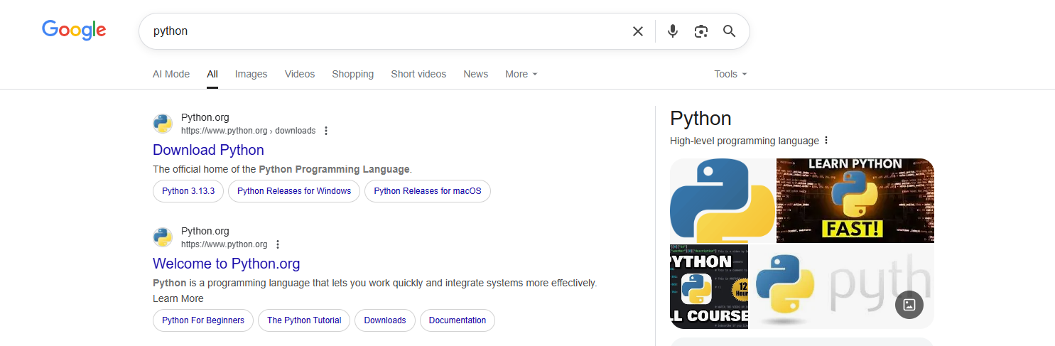
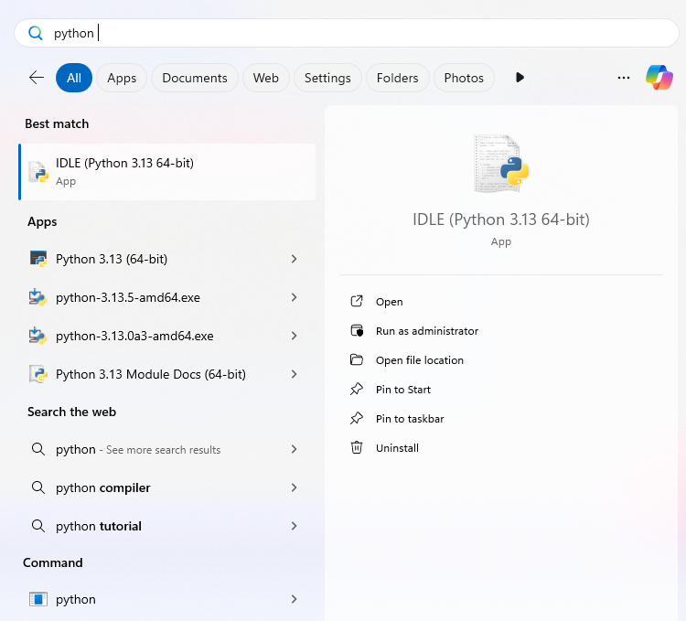
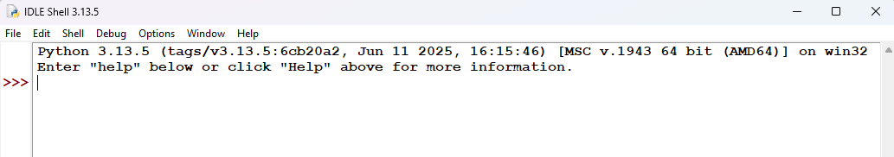
Installing Python
Search on Google for “Python” or Go to website https://www.python.org/downloads
Download Python 3.9.x (where x is the required version)
After downloading, open installer and click Installing and allow all the permission required.
In the end, you will get message for the installation finished.
Once it is installed restart the system
After restarting, search and open “Python IDLE shell”

Slide 6
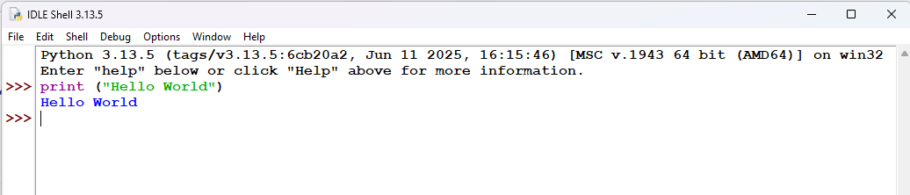
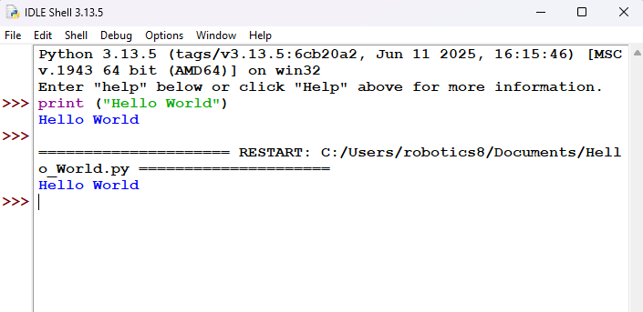
Working in Python
There are two modes: Interactive Mode or Python IDLE-Shell Mode and Script Mode or Editor
Python IDLE Shell Mode
One command at a time given for the result
You directly run code into the Python interpreter
It will not save anything
Python Editor Mode
Go to “File” and Click “New File” and then You can write the code
For saving, go to “File” and then click “Save” and choose the saving location.
Click on “Run” or Press “F5” to execute the program

Slide 7



Statements in Python
Simple Statements
A simple statement will be in a single line and end of a statement in done by “Enter Key” press
Multiline Statements
A multiline statement is extended over multiple lines.
For this, a line continuation character \ is used
This is useful in case of long calculations and can’t fit into one line.
Multiple Statements
It represents more than one statement in a single line.
It is done by using a semicolon (;)

Slide 8
Tokens
Tokens are the smallest meaningful unit of a program
Keywords
Those words which have special meaning & reserved for special purpose are Keywords.
Following are the keywords:
True, False, class, finally, is, return, None, continue, for, lambda, try, catch, pass, if, or as, else, break, in, global, while, with, and etc.
Identifiers
These are the user defined names of variables, list, dictionary, tuples etc.
Naming rules:
> An identifier can have letters in uppercase or lowercase, numbers or underscore
> It can’t begin with a number or underscore
> No special character like $, . , space etc. allowed
> It should not a keyword
> Uppercase and lowercase letters are different

Slide 9
Tokens
Tokens are the smallest meaningful unit of a program
Literals
It is defined as any data stored in a variable like “Hello”, ‘Python’.
There are following literals:
> Numeric Literals: 14, 20.5, 2+5j etc.
> Boolean Literals: True or False.
> Special Literals: None
Punctuators
These are special symbols to organise statements and expressions.
Examples: ‘ “ # / {} [] () @ , . : = |
Indentation
This is a space before a code line within its code block.

Slide 10
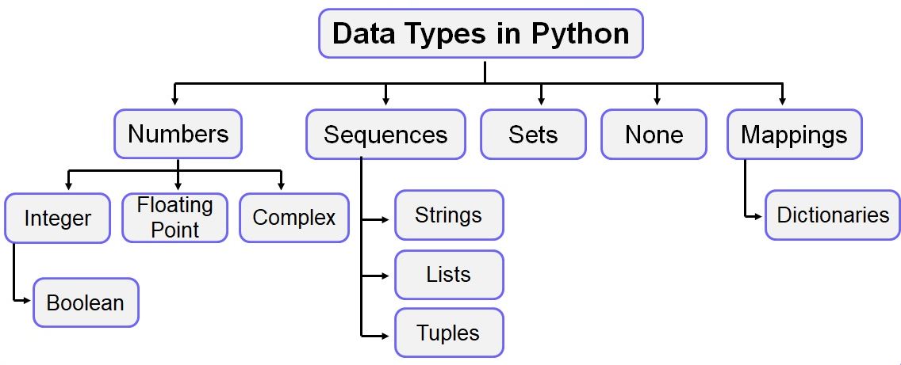
Introduction to Data Types and Variables
Data types are kind of value that a variable can store
like in maths for eg. x=2, y=0.4 etc.
There are types of data types as mentioned in diagram
Numbers
Numeric values come under this.
Following are some number types:
> Integer:
Positive, Negative or Zero without fractions or decimal values. Ex. 10, -5467, 0 etc.
> Float:
It is a real number with floating point representation.
Also, represented using exponent expression E.
Ex. 15.5, -234.000343, 1E5 etc.
> Complex: It includes real and imaginary numbers.
Ex. 3+2i where 3 is real number and i is imaginary number.

Slide 11
Introduction to Data Types and Variables
None
This is special data type with NULL/ no value.
Sequence
It is collection of data stored under a common name.
It is referred bt index number.
It can be mutable or non-mutable.
There are following types:
Strings
Lists
Booleans

Slide 12
Introduction to Data Types and Variables
Sequence - String
It is a sequence of UNICODE characters enclosed in single or double quotes.
Multi-line strings are created using triple quotes.
Length depends on available memory.
Example:
“ ”
“Hello”
‘Python’
“I love ‘Python’”
‘’’It is
an
Interesting Language’’’

Slide 13
Introduction to Data Types and Variables
Sequence - Lists
It is a sequence of heterogeneous values arranged as elements and is referred to by an index number.
These values are separated by a comma and are enclosed in square brackets [ ].
It is mutable data types as values of these data types can be changed by the user after creation.
Example:
list_of_names = [“Amit”, “Shweta”, “Peter”]
marks = [89, 92, 93, 78, 89]
class9 = [101, “Neha”, 89.5, 102, “Samosa”, 92]
Sequence - Tuples
Same as lists but it is non-mutable and () circular brackets are used.
Example:
list_of_fruits = (“Mango”, “Apple”, “Grapes”)

Slide 14
Introduction to Data Types and Variables
Sequence - Booleans
It is a data type with two built-in values: True or False where True value represents 1 and False value represents 0.
Sequence - Maps
These are kind of key-value pairs.
The key can be numbers or strings and values can be any arbitrary Python object.
Example:
dict = {}
Dict[‘hello’] = ‘This is Python’
Where ‘hello’ is the name of key of the dictionary variable and ‘This is Python’ is value.
Sequence - Sets
A set is an unordered collection data type that is iterable, mutable and has no duplicate elements.
Example:
var = {1,2,3,4,5}

Slide 15
Introduction to Data Types and Variables
Data Type Conversion
A data can be converted into another type by using type conversion built-in functions like int(), float(), str() etc.
This process is called Type Conversion or Typecasting.
Example
>>> float(12)
12.0
>>> int(15.5)
15
>>> str(12)
‘12’
>>> int(True)
1
>>> bool(0)
False
You can get data type of any object by using type()
Example
>>> type(10)
<class ‘int’>
>>> type(‘abc’)
<class ‘str’>
>>> type(14.5)
<class ‘float’>

Slide 16
Introduction to Data Types and Variables
Variables
It is a name given to a memory allocation to hold a specific value. It is like a container that can hold any type of data.
A name follows rules of Identifiers while value can be integer, float, string, boolean, etc.
There are different ways of assigning values to variables like these:
Method 1
>>> a = 5
>>> b = 10.5
>>> c = “hello”
Method 2
>>> a = 5; b = 10.5; c = “hello”
>>> a, b, c = 5, 10.5, “hello”
Method 3
>>> a = b = c = 10

Slide 17
Thanks For Joining
^_^

