Slide 1
Chapter 3:
Components of Robots as a System
Part - 3

Slide 2

Actuators
What is an Actuator?
Converts electrical, hydraulic, or pneumatic energy into mechanical motion
Enables robots to move, apply force, and interact with their environment
Vital for executing robotic tasks across multiple domains
Applications of Actuators
🤖 Robot Manipulation
Power robotic arms, grippers, and joints
Enable tasks like grasping, lifting, and positioning
🚗 Robot Mobility
Drive wheels, legs, or tracks
Allow robots to navigate terrain and perform locomotion (walking, flying, etc.)
🏭 Industrial Automation
Used for assembly, welding, painting, etc.
Provide precision and repeatability in manufacturing
🏥 Medical Robotics
Power surgical tools, prosthetics, exoskeletons
Enable accurate, safe motion in healthcare applications

Slide 3
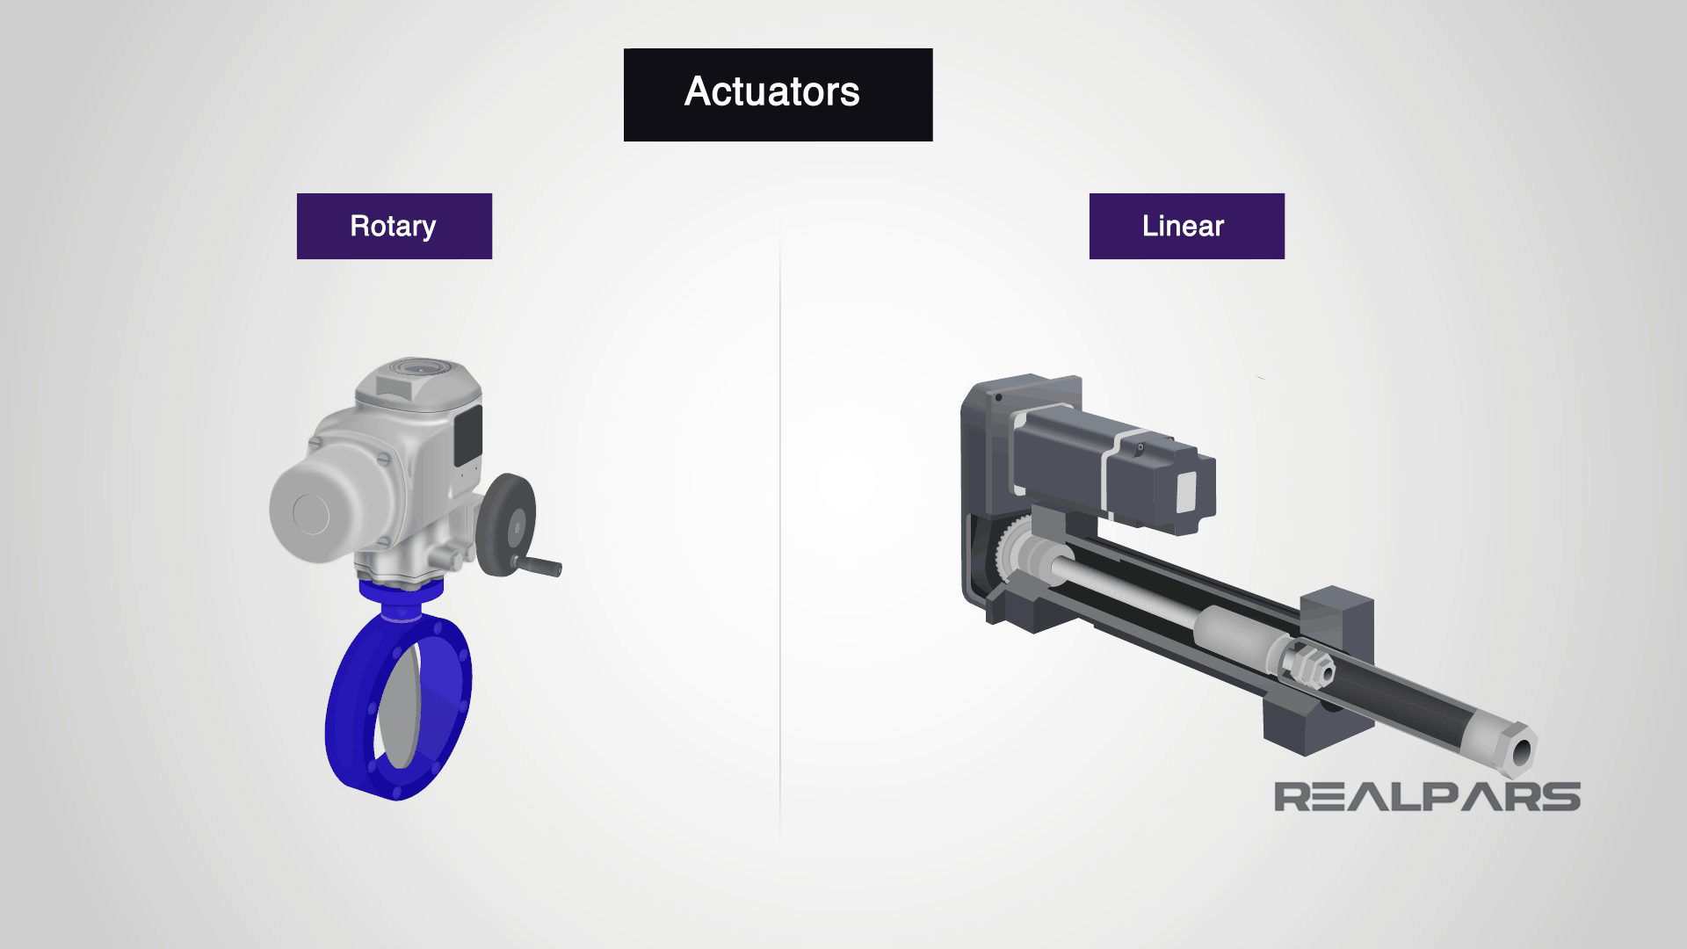
Types of Actuators
What is a Linear Actuator?
Produces straight-line (linear) motion
Converts electrical, hydraulic, or pneumatic energy into linear displacement
Used in:
  Robotic arms
  Grippers
  Sliding mechanisms
Types of Linear Actuators
Electric Linear Actuators
Use motors + lead/ball screws
Precise, compact, easy to control
Ideal for automation & robotics integration
💧Hydraulic Linear Actuators
Use fluid pressure to move pistons
High force, suitable for heavy-duty tasks
Used in industrial and construction robots
💨 Pneumatic Linear Actuators
Use compressed air to move pistons or diaphragms
Fast response, low-force applications
Common in lightweight automation systems

Slide 4
Types of Actuators
What is a Rotary Actuator?
Produces rotational motion around a fixed axis
Converts electrical, hydraulic, or pneumatic energy into rotation
Used in:
  Robotic joints
  Wheels & arms
  Spinning mechanisms
Types of Rotary Actuators
Electric Rotary Actuators
Use DC, stepper, or servo motors
Precision & programmable control
Ideal for joint movement & small-scale robotics
💧 Hydraulic Rotary Actuators
Use fluid pressure to rotate pistons or vanes
✔ High torque for heavy machinery
💡 Used in industrial robotic arms
💨 Pneumatic Rotary Actuators
Use compressed air to generate quick rotations
✔ Fast, low-torque movement
💡 Common in lightweight or repetitive-motion systems

Slide 5
Joints
What are Joints?
Joints enable the articulation and movement of robot limbs or segments
Types of Joints
Electric Motor-Driven Joint
Different motors are used as joints like DC Motors, Stepper Motors or Servo Motors.
It provides exact control angles and are very versatile
Hydraulic Rotary Joint
For the working of these joints, hydraulic actuators are used that used fluid
There are used in heavy duty robots or construction.
Pneumatic Rotary Joint
These joints uses compressed air or gas to make joints move
Basically, movements are done using pneumatic actuators

Slide 6
Wheels
What are Wheels?
Joints enable the articulation and movement of robot limbs or segments
Types of Joints
Electric Motor-Driven Joint
Different motors are used as joints like DC Motors, Stepper Motors or Servo Motors.
It provides exact control angles and are very versatile
Hydraulic Rotary Joint
For the working of these joints, hydraulic actuators are used that used fluid
There are used in heavy duty robots or construction.
Pneumatic Rotary Joint
These joints uses compressed air or gas to make joints move
Basically, movements are done using pneumatic actuators

Slide 7
Thanks For Joining
^_^

