Slide 1
Chapter 3:
Components of Robots as a System
Part - 2

Slide 2
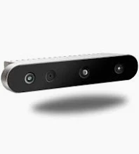
Sensors in Robotics
Sensors process robot’s condition and environment to enable robot to perceive and interact.
It collects data and information like human sensory organs.
Vision Sensor
Captures visual information like a human eye
Helps in:
  Object recognition
  Tracking & navigation
  Visual feedback
Example: Camera (RGB, Depth, Stereo, etc.)
Uses
Image processing & computer vision
Deep learning for:
  Visual tracking
  Gesture-based interaction
  Scene understanding
Example: Microsoft Kinect
Combines:
  RGB camera – captures color images
  Infrared projector – for depth sensing
  Depth sensor – measures distance of each pixel
Creates a 3D map of environment
Enables:
  Estimating size, position, shape
  Obstacle detection & gesture recognition

Slide 3
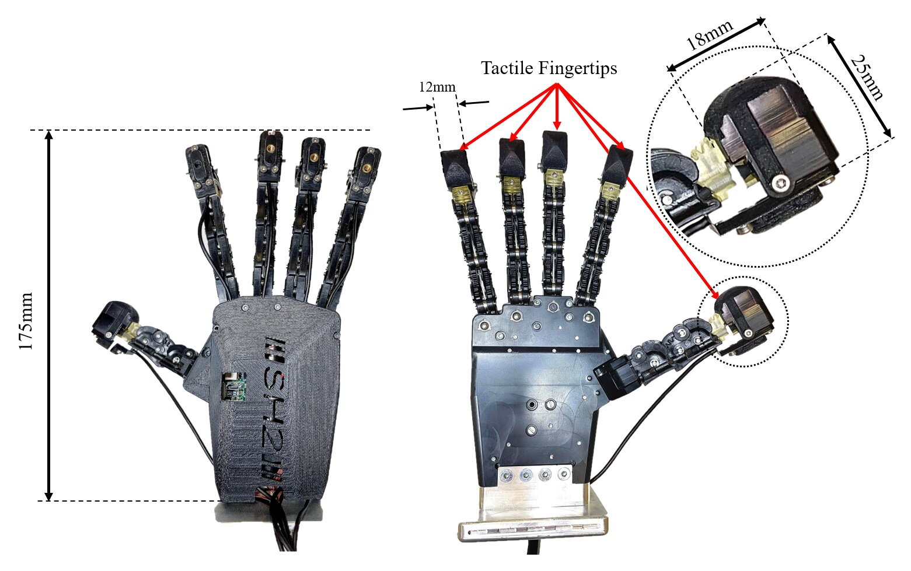
Sensors in Robotics
Tactile Sensor
What is a Tactile Sensor?
Detects physical contact, pressure, or force
Mimics the human sense of touch
Key for:
  Object manipulation
  Force control
  Grasping
  Human-robot interaction
Application in Robotics
Mounted on robot arms or end effectors
Adjusts grip strength during object handling
Detects:
  Successful grasp
  Slipping or unexpected forces
Example: Pressure-Sensitive Mat
Made of sensor arrays using:
  Piezoresistive
  Capacitive
  Piezoelectric technologies
Detects:
  Pressure magnitude
  Force distribution
  Contact location

Slide 4
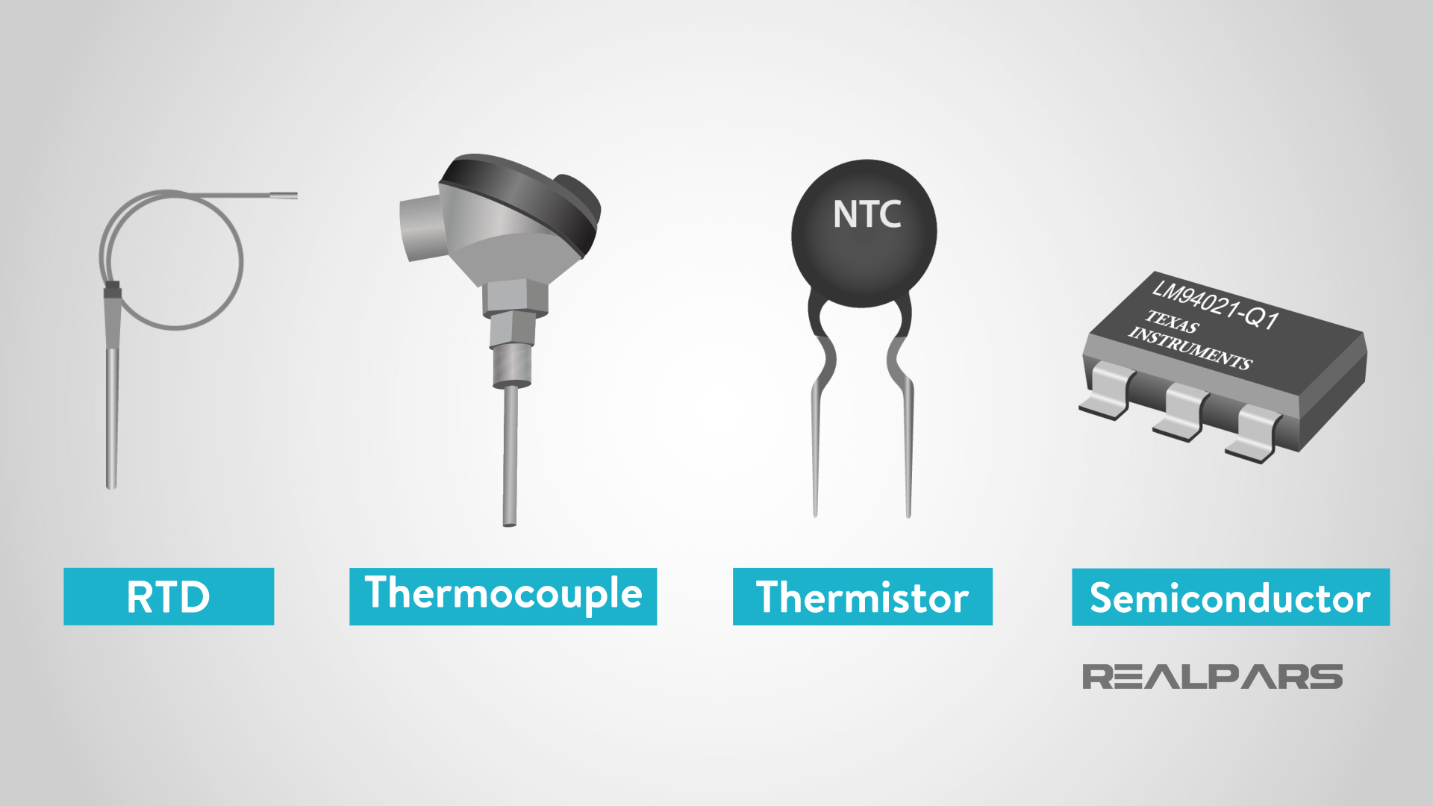
Sensors in Robotics
Temperature Sensor
What is a Temperature Sensor?
Measures temperature of surroundings or objects
Enables:
  Thermal monitoring
  Safety & process control
  Environmental sensing
  Heat management
Applications
Industrial robots: Prevent overheating
Environmental robots: Ambient temp monitoring
Smart robots: Adjust actions based on thermal data
Types
1. Thermocouple
2. RTD (Resistance Temperature Detector)
3. Others
Thermistor: Sensitive to small temp changes
Infrared Sensor: Detects IR radiation, non-contact

Slide 5
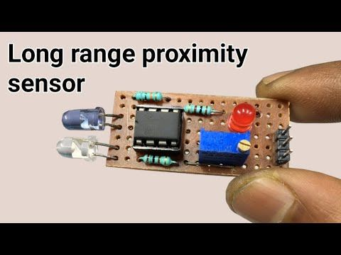
Sensors in Robotics
Range and Proximity Detection Sensor
What is a Range and Proximity Detection Sensor?
Measure distance between robot and nearby objects
Enable:
Obstacle detection
Safe navigation
Accurate positioning
Applications
Obstacle avoidance
Distance-based path planning
Object detection for manipulation
Ultrasonic Sensors
Emit high-frequency sound waves
Measure time of echo to calculate distance
✔ Effective in indoor navigation & collision avoidance
💡 Example: Robot detects obstacles by how fast the echo returns
Infrared (IR) Sensors
Emit infrared light, detect reflected intensity
Stronger reflection = closer object
✔ Used in line following, wall following, object detection
💡 Example: Robot uses IR sensor to follow maze walls

Slide 6
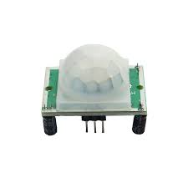
Sensors in Robotics
Motion Sensor
Motion sensors detect movement, direction, or speed in the environment, enabling robots to respond to changes around them.
Types of Motion Sensors
1. Passive InfraRed (PIR) Sensors
Detect infrared radiation emitted by warm objects (e.g., humans, animals)
Use pyroelectric sensors to sense body heat
Example: Robot detects a person entering a room and reacts accordingly
🔁 Applications: Security, home automation, interactive robots
2. Optical Encoders
Measure position, speed, or rotation direction of motors/joints
Components: Light source + slotted disk + photodetector
Example: Robot arm uses encoders for precise joint control
Key Roles in Robotics
Motion detection & tracking
Navigation & path planning
Human-robot interaction
Security & automation

Slide 7
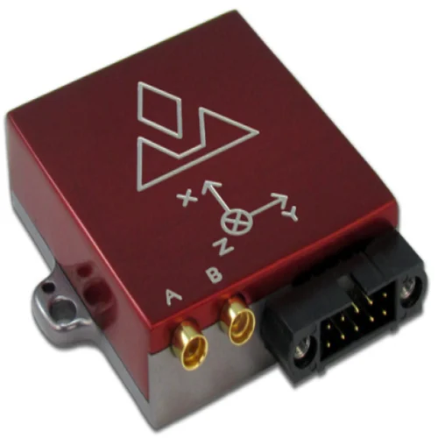
Sensors in Robotics
Navigation Sensor
Navigation sensors help robots determine their position, orientation, and movement within an environment. They are essential for autonomous navigation, localization, and mapping.
1. GPS (Global Positioning System)
Uses satellite signals to calculate latitude, longitude, and altitude
Provides global positioning, velocity, and time synchronization
📍 Example: Autonomous vehicles use GPS to follow routes and track real-time location
⚠️ Limitation: Accuracy may degrade in obstructed areas (e.g., cities, indoors)
🔦 2. LIDAR (Light Detection and Ranging)
Emits laser pulses to measure distance to objects
Generates detailed 3D maps (point clouds) of surroundings
🛻 Example: Used in self-driving cars and drones for mapping, localization, and obstacle detection
Key Roles in Robotics
Autonomous vehicles & drones
Warehouse & delivery robots
Surveying, mapping & exploration

Slide 8
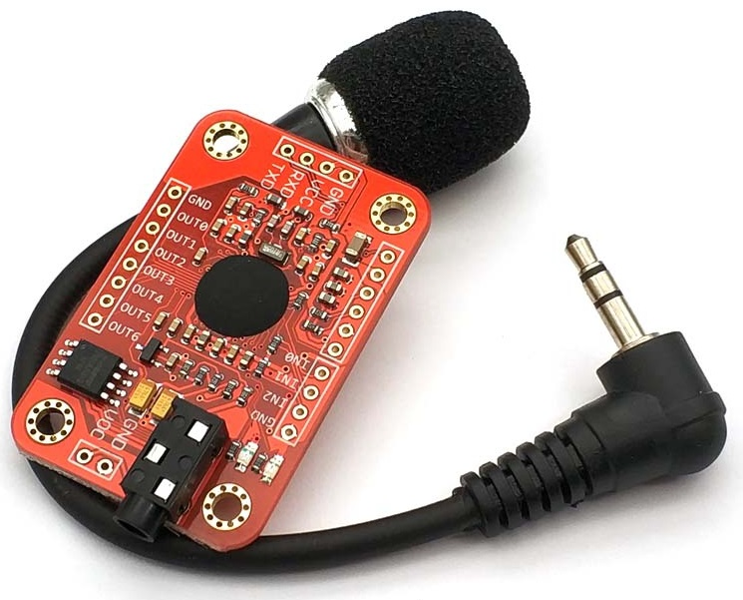
Sensors in Robotics
Speech Recognition Sensor
Though not a physical sensor, speech recognition is a technology that allows robots to convert spoken language into text or commands, enabling natural human-robot interaction.
How It Works
Captures audio input (spoken words)
Analyzes speech for words, pronunciation, and context
Converts speech into text using Natural Language Processing (NLP)
Robot interprets the command and executes actions accordingly
Example: Voice-Controlled Personal Assistants
Tools: Alexa, Google Assistant, Siri
Used in smart speakers, home automation, robots
🗨️ E.g., User says: “Robot, turn on the lights”
→ Speech is transcribed → Robot activates light system
Key Roles in Robotics
Home automation systems
Customer service robots
Assistive robots for elderly or disabled
Voice-controlled devices

Slide 9
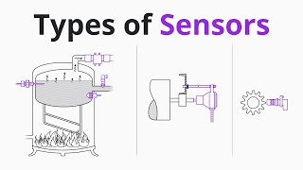
Types of Sensors

Slide 10
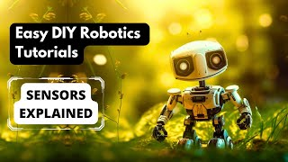
Video Session - Sensors Explained

Slide 11
Thanks For Joining
^_^

