Slide 1
Chapter 3:
Components of Robots as a System
Part - 1

Slide 2
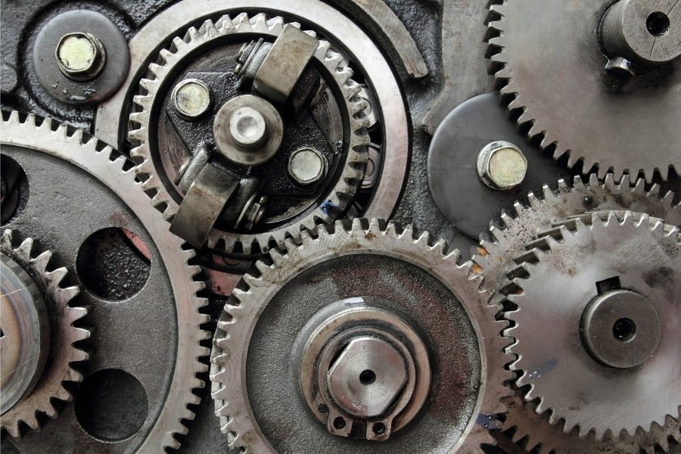
Introduction to Gears
What Are Gears?
Gears are mechanical devices with toothed wheels or cylinders
It is used to transmit motion, torque, and speed between rotating shafts
⚙️ How Gears Work
Teeth are precisely shaped to mesh together
Rotation of one gear drives another
Enables changes in:
  🔄 Speed
  🔁 Direction
  💪 Torque

Slide 3
Principles of Gears
⚙️ Why Gears Matter
Used in everything from simple machines to advanced robotics
Governed by mechanical principles that ensure precise operation
🔑 Fundamental Principles
Transmission of motion and power between components
Speed adjustment using different gear sizes
Torque conversion for adapting to different loads
Directional control using gear arrangements (e.g., bevel gears)
Gear reduction/amplification to optimize speed or power
Mechanical advantage to increase or reduce force output

Slide 4
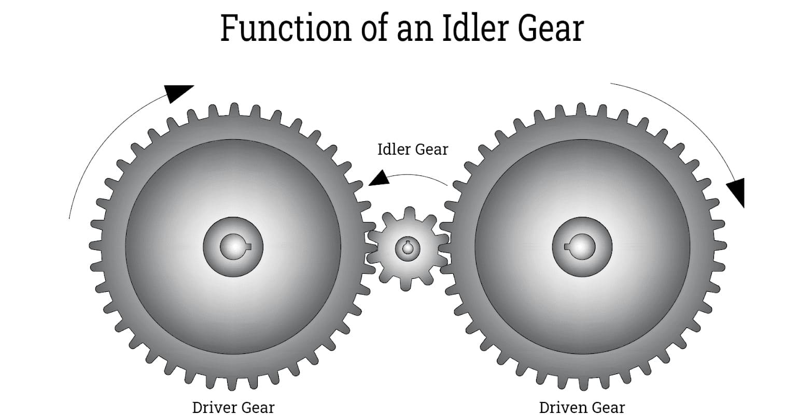
Principles of Gears
Functions of Gears
🚀 Key Functions in Mechanical Systems
Transmission: Transfers rotational motion & torque between shafts
Speed Adjustment: Changes speed using gear ratios
Torque Conversion: Increases or decreases torque output
Directional Control: Alters rotation direction (e.g., 90° turns)
Gear Reduction/Amplification:
  Small gear → Large gear: 🔽 Speed, 🔼 Torque
  Large gear → Small gear: 🔼 Speed, 🔽 Torque
Mechanical Advantage: Multiplies force for heavy-duty tasks

Slide 5
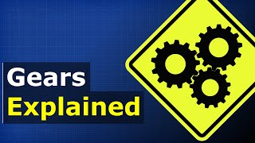
Principles of Gears

Slide 6
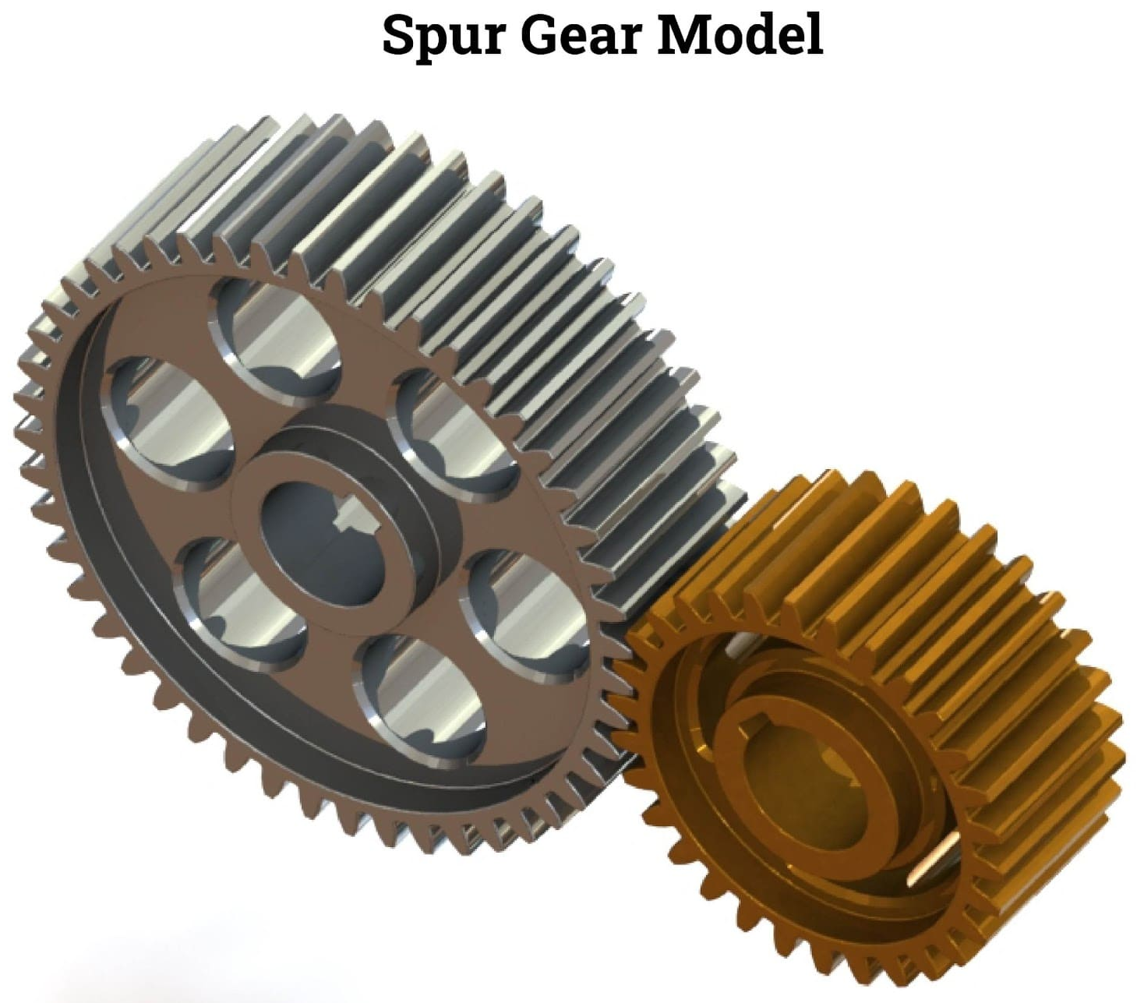
Types of Gears and their Uses
Spur Gears
Definition:
Spur gears are the most common and simplest type of gear used in robots. They consist of cylindrical wheels with straight teeth aligned parallel to the gear axis.
🔹 Key Features:
Tooth Profile: Straight, radial teeth (usually involute profile).
Meshing: Transmit motion and power between parallel shafts.
Efficiency: Highly efficient for power transmission.
🔹 Gear Ratio: Gear Ratio = Teeth on Driving Gear/Teeth on Driven Gear​
Example: 20T driving gear & 40T driven gear → Gear Ratio = 2:1
🔹 Speed & Torque:
Speed ↓, Torque ↑ when gear ratio > 1
Speed ↑, Torque ↓ when gear ratio < 1
🔹 Example Application:
A motor drives a 20T spur gear at 1000 RPM → connected to a 40T gear on a robotic arm.
Result:
Speed = 500 RPM
Torque = 2× input torque
🔹 Uses in Robotics:
Joint mechanisms
Gearboxes
Drive systems

Slide 7
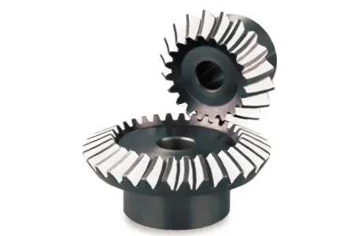
Types of Gears and their Uses
Bevel Gears
Definition:
Bevel gears are used to transmit rotational motion between intersecting shafts. They feature conical-shaped teeth and operate at various shaft angles.
🔹 Key Features:
Tooth Profile: Involute teeth on a conical surface
Shaft Orientation: Transmit motion between shafts at angles (e.g., 90°)
Meshing: Smooth engagement with efficient torque transfer
🔹 Types of Bevel Gears:
Straight Bevel Gears:
  Straight, tapering teeth
  Commonly used for 90° shaft rotations
Spiral Bevel Gears:
  Curved spiral teeth
  Quieter & smoother for high torque applications
🔹 Example Application:
A robotic arm requires motion transfer at a 90° angle.
Two straight bevel gears with equal teeth ensure a 1:1 ratio, rotating the second shaft perpendicularly with equal speed and torque.
🔹 Uses in Robotics & Systems:
Robotic joints with angled motion
Differentials
Vehicle drivetrains
Steering mechanisms

Slide 8
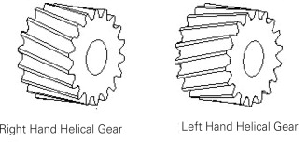
Types of Gears and their Uses
Helical Gears
Definition:
Helical gears are similar to spur gears but have angled (helical) teeth, enabling smoother, quieter, and more efficient torque transmission.
🔹 Key Features:
Tooth Profile: Slanted, spiral-shaped teeth (helical angle)
Helix Direction:
  Right-hand or Left-hand helix
  Affects axial thrust direction
Axial Thrust: Generated due to angled teeth; requires support (e.g., thrust bearings)
Meshing: Gradual engagement → less noise & shock, smoother operation
🔹 Example Application:
In a robotic arm, helical gears are used for high torque & quiet movement.
Right-hand helix on both driving & driven gears ensures smooth and controlled operation.
🔹 Common Uses in Robotics:
Gearboxes
Robotic joints
Power transmission systems: Ideal when noise reduction, smoothness, and torque strength are required.

Slide 9
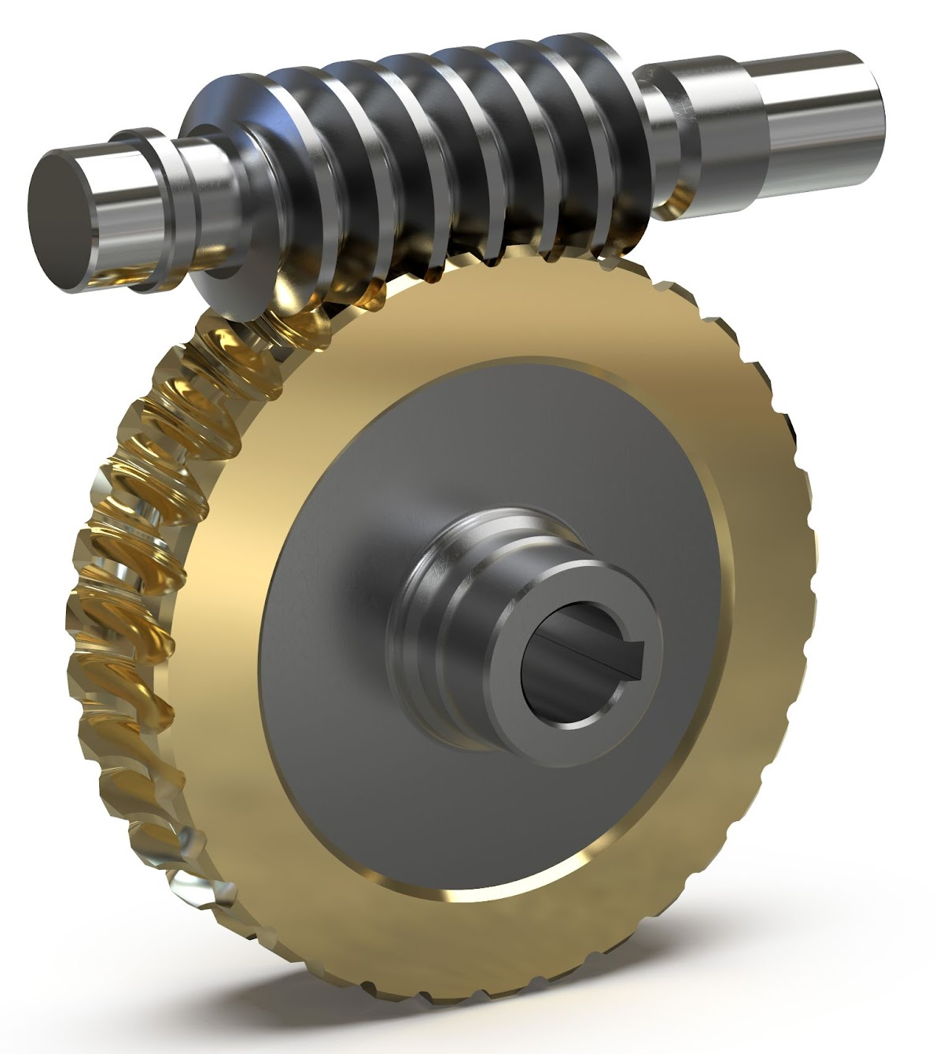
Types of Gears and their Uses
Worm Gears
Definition:
Worm gears consist of a screw-like worm and a toothed worm wheel, used to transmit motion and torque between perpendicular shafts with high torque and low speed.
🔹 Key Features:
Worm Structure: Helical thread (usually single-threaded)
Worm Wheel: Toothed gear that meshes with the worm
Shaft Orientation: Driving and driven shafts are perpendicular
🔹 Gear Ratio = Teeth on Worm Wheel​/Threads on Worm
Example: 1-thread worm & 40-tooth wheel → 40:1 → High torque, low speed
🔹 Advantages:
High torque output
Self-locking: Prevents back-driving → great for holding loads in place
🔹 Example:
A robotic arm lifting a heavy load uses a worm gear with self-locking to hold the position without slipping, ensuring safety and precision.
🔹 Uses in Robotics:
Robotic grippers
Lifting mechanisms
Joint locks
Slow-speed drives

Slide 10
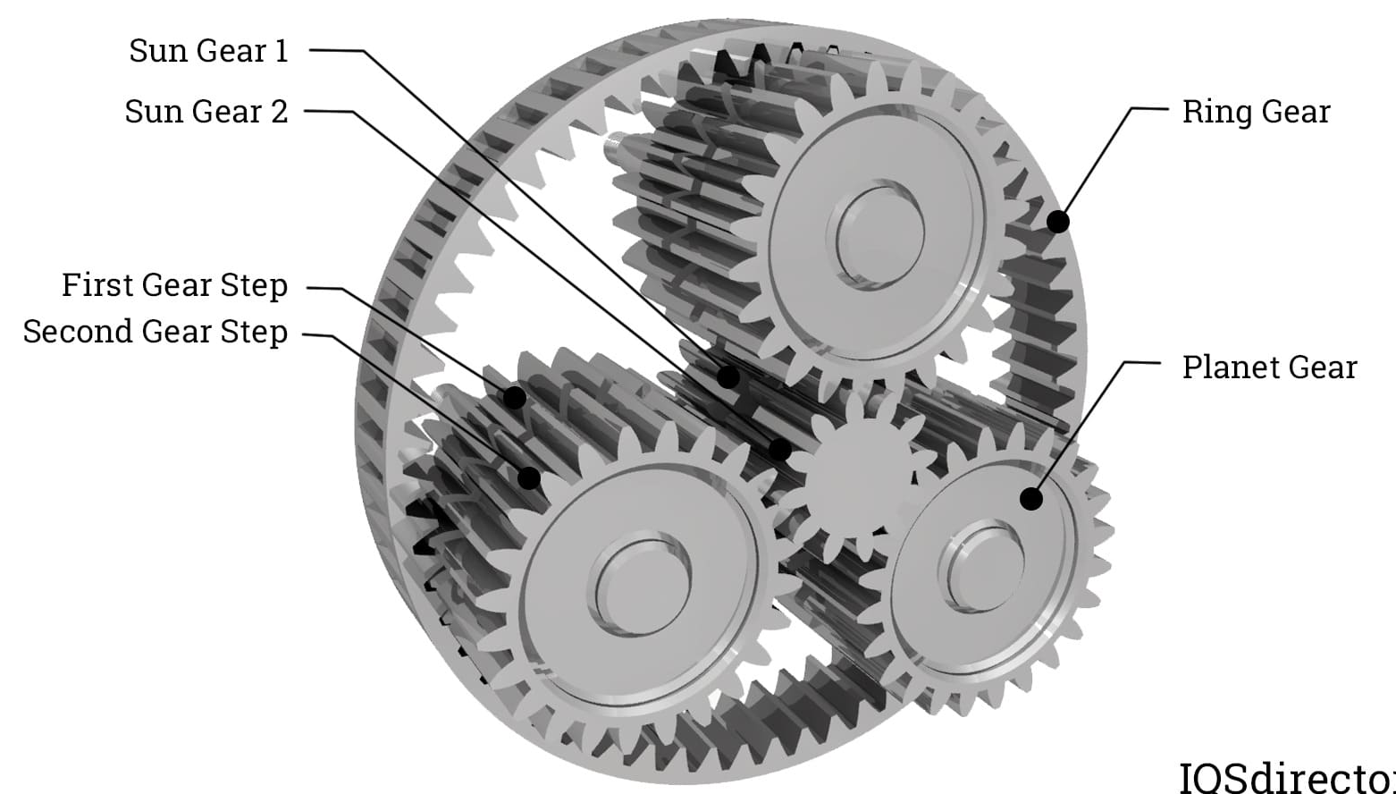
Types of Gears and their Uses
Planetary (Epicyclic) Gears
Definition:
Planetary gears consist of a Sun Gear (center), Planet Gears (around the sun), Ring Gear (outer), and a Carrier that holds the planet gears. They offer multiple gear ratios and high torque in compact design.
🔹 Key Components:
Sun Gear: Central input gear
Planet Gears: Mesh with both sun & ring gear, rotate on a carrier
Ring Gear: Outer gear with internal teeth
Carrier: Holds & rotates the planet gears
🔹 Gear Ratios & Functions:
Speed Reduction: Sun input, ring output → Gear ratio > 1
Speed Increase: Ring input, sun output → Gear ratio < 1
Torque Amplification: Sun input, ring fixed → Increased torque
Reversible Output: Fix 2 components, rotate the 3rd
🔹 Example Calculation:
Sun gear: 20 teeth
Planet gears: 10 teeth
Ring gear: 40 teeth
Gear Ratio = 2:1 → Torque ↑, Speed ↓
🔹 Uses in Robotics & Beyond:
Robotic arms & joints
Precision motion systems
Automotive transmissions
Aerospace mechanisms

Slide 11
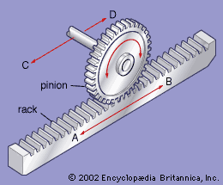
Types of Gears and their Uses
Rack and Pinion Gears
Definition:
Rack and pinion gears convert rotational motion (pinion) into linear motion (rack), offering precise motion control in robotics and mechanical systems.
🔹 Key Components:
Rack: Flat, linear gear with straight teeth
Pinion: Circular gear that meshes with the rack
Motion Conversion: Rotation of the pinion → linear movement of the rack
🔹 Function & Control:
Enables precise linear motion
Direction of rack movement depends on pinion rotation direction
Gear ratio affects force and speed amplification
🔹 Example Application:
Car Steering System: Pinion on steering column → rotates rack → moves wheels
Robotics: Used in linear actuators for arms, sliders, and positioning systems
🔹 Uses in Robotics & Systems:
Robotic arms
CNC machines
Steering & control mechanisms

Slide 12
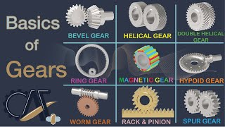
Types of Gears and their Uses

Slide 13
Thanks For Joining
^_^

