Slide 1
Chapter 1:
New Age Robotic System
Part - 4

Slide 2
Robotics for Medicine and Healthcare Industry
Robotics are used in wide range of applications in Healthcare industry.
For example, surgical interventions, telemedicine, physical therapy.
It involves around precision and facilitate rehabilitation.
Example: Da Vinci Surgical System
This is the company that manufactures systems consisting of robotic arms
These systems are typically used by surgeons to do complex surgical operations
The robot translates the surgeon’s hand movement into precise scaled movements of the instruments

Slide 3
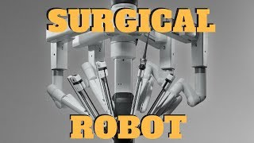
Robotics for Medicine and Healthcare Industry

Slide 4
Robotics for Medicine and Healthcare Industry
Benefits
Improved Surgical Outcomes
Surgical Robots provides better visualization during operation to the surgeon.
It reduces complications and faster recovery of patients.
Increased Surgical Capabilities
The surgeon can operate on difficult parts to reach with ease.
It can map the 3D view of the body part for better precision.
Reduced Trauma and Pain
Using Surgical Robots, only targeted parts are operated because of it causes less pain and quick healing.
In open surgeries, the body is cut beyond required to get the check up.

Slide 5
Robotics for Medicine and Healthcare Industry
Benefits
Remote Access to Expertise
These robots can be operated from remote place, may be from some other city or country.
Patients can get better surgeries without have to move to different places.
Training and Education
In order to get hands on experience, Surgical Robots are best choice to learn from.
These robots can help avoid operations on patients without experience.

Slide 6
Robotics For Agriculture
Robots that are used in agriculture are called Agribots
These are designed for planting, harvesting, monitoring crop health and precision spraying.
Autonomous or Semi-Autonomous Drones, Harvesting Robots etc. come into this categories.
Example: Autonomous Tractors by John Deere
This tractor used GPS, sensors, remote control and pre-programming for movements.
It comes in a EV version.
There is no sitting arrangement inside of it, so there is no human inside.
Multiple types of tools and modular attachments for ploughing, seeding, harvesting etc.

Slide 7
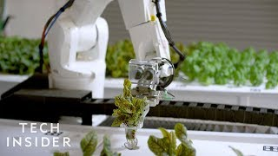
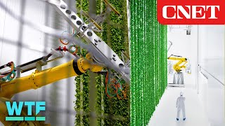
Robotics For Agriculture

Slide 8
Robotics For Agriculture
Examples with Benefits
Harvesting Robots
These robots are used to automate the picking of fruits, vegetables or crops.
Computer Vision and Sophisticated Robot Arms are used for identification and pick & place into containers
Autonomous Tractors
GPS, sensors and mapping tech. enables these bots for plowing, seeding, and fertilizing.
Improve precision, reduce soil impact, and enhance yields
Weed Control Robots
These robots also use computer vision and AI algorithms to identify and remove weeds.
It reduces use of weedicides for reduce crop pollutants and targets selective weeds.

Slide 9
Robotics For Agriculture
Examples with Benefits
Crop Monitoring & Spraying Robots
It use sensors and imaging to track crop health and sprays fertilizers accordingly.
Cameras, spectrometers and multispectral imaging systems are integrated to robots.
Autonomous Greenhouse Robots
These robots manage climate, light, and irrigation automatically in a controlled environment
Different parameters are used like temperature, humidity and lighting is used.
Robotic Dairy Farming
It automate milking and feeding processes of cattles, dairy animals and poultry animals.
Robotics milking machines, Automated Incubators are examples.

Slide 10
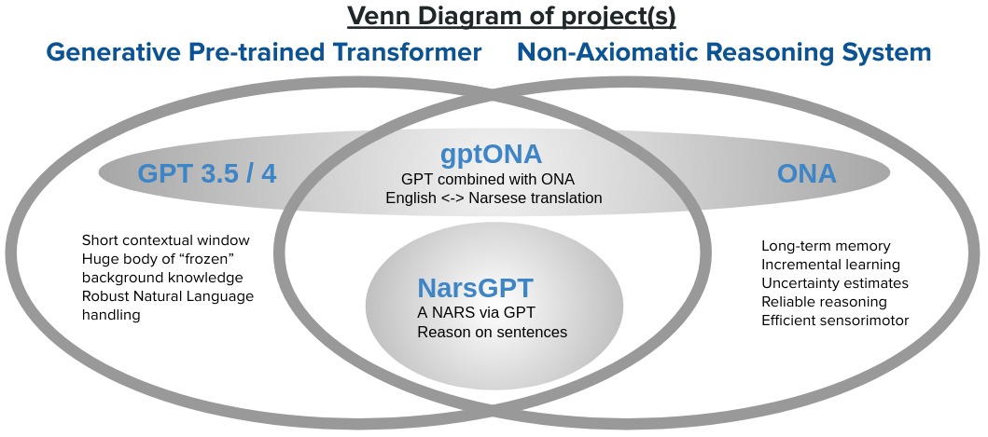
NARS (Non-Axiomatic Reasoning Systems)
What is NARS?
A cognitive architecture developed by Pei Wang
Designed to model human-like reasoning and learning
Operates with insufficient knowledge and resources
Key Characteristics:
No fixed axioms – knowledge is self-generated
Combines deductive and inductive reasoning
Uses term logic for knowledge representation
Employs non-monotonic reasoning – conclusions can be revised
Reasoning Cycle:
Attention Allocation
Inference
Judgment
Learning

Slide 11
NARS (Non-Axiomatic Reasoning Systems)
Learning from Experience:
Learns via anticipation and update
Compares predictions vs outcomes
Adjusts its knowledge base to improve reasoning
Significance in AI & Cognitive Science:
Models flexible, adaptive intelligence
Addresses uncertainty and incomplete information
Reflects essential aspects of human cognition
Why It Matters:
NARS shows how AI can function without predefined knowledge
Contributes to understanding the nature of intelligence

Slide 12
Why NARS are Relevant and Possible?
1. Broader Educational Assessment
Moves beyond grades and test scores
Evaluates students' skills, talents, and growth holistically
2. Cognitive Architectures
Flexible, adaptive systems that handle uncertainty
Learn from experience using non-axiomatic reasoning
3. Artificial General Intelligence (AGI)
Supports the development of systems with human-like cognition
Encourages reasoning without fixed knowledge structures
4. Knowledge Representation & Reasoning
Uses term logic for language-like knowledge expression
Combines deductive and inductive reasoning

Slide 13
Why NARS are Relevant and Possible?
5. Cognitive Science & Psychology
Models human reasoning and decision-making
Supports testing of cognitive hypotheses
6. Intelligent Tutoring Systems
Learns via anticipation and update
Enables personalized feedback and adaptive learning paths
Optimizes the educational experience for individual learners

Slide 14
Components to Illustrate Functioning of NARS
1. Term Logic – Knowledge Representation
Uses a language-like formalism
Concepts + relations = Terms
Example: “Birds can fly”
  Concepts: Birds, Fly
  Relation: Can
Enables structured, manipulable knowledge
2. Attention Allocation
Assigns processing priority based on relevance
More important tasks = more attention
Example: A surprising new fact gets more attention than routine info

Slide 15
Components to Illustrate Functioning of NARS
1. Term Logic – Knowledge Representation
Uses a language-like formalism
Concepts + relations = Terms
Example: “Birds can fly”
  Concepts: Birds, Fly
  Relation: Can
Enables structured, manipulable knowledge
2. Attention Allocation
Assigns processing priority based on relevance
More important tasks = more attention
Example: A surprising new fact gets more attention than routine info

Slide 16
Components to Illustrate Functioning of NARS
3. Inference and Judgment
Deductive Reasoning: Logical conclusions from rules
Inductive Reasoning: Generalizations from examples
Judgment: Assigns truth value and confidence
Example: “Penguins are birds → Birds can fly → But Penguins can’t fly”
→ Adjusts confidence through judgment
4. Learning and Anticipation
Mechanism: Anticipation and Update
Predicts outcomes → compares with actual results
Matches = reinforced knowledge
Mismatches = knowledge revised or updated

Slide 17
Components to Illustrate Functioning of NARS
Example of Deduction:
Statement 1: All mammals are animals
Statement 2: Elephants are mammals
Inferred Statement 3: Elephants are animals
How NARS Handles This:
Uses deductive reasoning to infer new knowledge
Assigns a degree of truth to the conclusion
Degree is based on evidence strength and system's existing knowledge
Reasoning is non-monotonic – new evidence can revise conclusions

Slide 18
Components to Illustrate Functioning of NARS
Deep Learning (DL):
Views learning as function approximation
Input → Algorithm → Output
Trained on data to learn specific mappings
Output is determined by a learning algorithm using training data
Goal: Converge to a fixed model or function
🔁 Key Traits:
Deterministic or probabilistic
Finite, often task-specific
Output predictable after training is complete

Slide 19
Components to Illustrate Functioning of NARS
NARS's View of Learning:
Learning = Adaptation + Self-Organization
Not a fixed function – response depends on history and context
Lifelong learning – never converges to a final state
Continuously updates beliefs with new information
🌱 Why It Matters:
Flexible in the face of change
Better at dealing with uncertainty, novelty, and incomplete knowledge
More aligned with human-like cognition

Slide 20
Thanks For Joining
^_^

