Slide 1
Chapter 1:
New Age Robotic System
Part - 3

Slide 2
Autonomous Cars/Driver-Assisted Cars
These types of cars are capable of moving from one point to other point.
Most autonomous cars use ADAS technology (Advanced Driver Assistance System).
This technology includes use of sensors and software to do lane-keeping, steering and braking.
Example: Waymo
Waymo is a autonomous car booking company which makes driverless cars for customers.
It uses advanced Lidars, Depth camera, Ultrasonic sensors and AI to make a map of surrounding and the city.
It is currently provides services in cities like Phoenix, San Francisco and Los Angeles.
Waymo claims its cars can avoid upto 85% of crash-related injuries compared to human drivers.

Slide 3
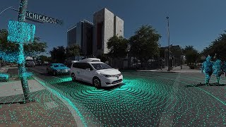
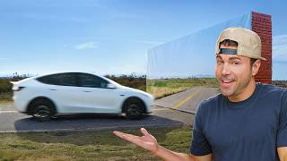
Autonomous Cars/Driver-Assisted Cars

Slide 4
Autonomous Cars/Driver-Assisted Cars
Benefits
Enhanced Safety
Advanced sensor systems combined with AI algorithm reduces number of accidents.
It can also help avoid human caused error like distracted driving or slow decision making.
Increased Efficiency and Traffic Management
These cars are designed to optimise traffic flow by exchanging the information between cars.
It can adjust speed according to the route and minimum braking system to save fuel and time.
Accessibility and Mobility for All
Since these are driverless car, so it doesn’t require any driver license to move around.
It can also be used as ridesharing services to go anywhere without owning the car.

Slide 5
Autonomous Cars/Driver-Assisted Cars
Benefits
Environmental Benefits
The car can be programmed to optimise fuel efficiency and reduce emissions.
Most autonomous car coming in markets are electric vehicles.
New Business Models and Services
This will promote of ride sharing and taxi services a lot.
It can be as much utilized in limited amount of time.

Slide 6
Autonomous Drones
Also known as Unmanned Aerial Vehicles (UAVs)
Operate without human intervention
Equipped with sensors, GPS, and onboard computers
Capable of pre-programmed flights, obstacle avoidance, and task execution
Example: Drone Delivery System
The product is securely packed into a lightweight container compatible with the drone.
The drone’s software calculates the optimal, GPS-guided route to the delivery destination.
The drone takes off, navigates the route, avoids obstacles using sensors, and descends for delivery.
The package is lowered or dropped at a designated spot; the drone then returns to base.

Slide 7
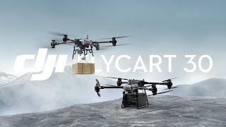
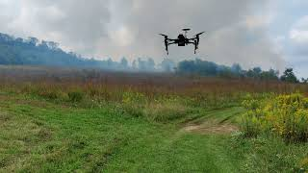
Autonomous Drones

Slide 8
Autonomous Drones
Benefits & Usage
📷 Aerial Photography & Videography
Used in film, advertising, and documentaries
Follow set paths for high-quality, dynamic footage
🌱 Agriculture
Crop monitoring, spraying, and health assessment
Use of multispectral & thermal sensors
🏗️ Construction & Infrastructure
Surveying sites and inspecting structures
Increases efficiency and safety
📦 Logistics & Delivery
Used in last-mile delivery (e.g., Amazon, UPS)
Ideal for remote or hard-to-reach areas
🆘 Search & Rescue
Operate in dangerous terrains
Equipped with thermal cameras and imaging tech
🌍 Environmental Monitoring
Survey wildlife, ecosystems, and deforestation
Collect large-scale environmental data

Slide 9
Autonomous Drones
Benefits & Usage
🎯 Intelligence, Surveillance & Reconnaissance (ISR)
Real-time intel gathering and situational awareness
Long-duration, large-area operations
🔎 Target Acquisition
Identify and track threats
Support mission planning and targeting
🪖 Battlefield Support
Resupply missions, troop monitoring, and rescue ops
Works with manned and unmanned teams
🛡️ Anti-Submarine Warfare (ASW)
Drones with sonar and underwater sensors
🐝 Swarm Warfare
Multiple drones operate in coordination
Ideal for attacks, recon, and disruption

Slide 10
Thanks For Joining
^_^

