Slide 1
Chapter 1:
New Age Robotic System
Part - 1

Slide 2

The New Age Robotics System
Bringing robotics to classrooms and industries to boost efficiency, productivity, and safety.
Enhanced Autonomy and Intelligence
Equipped with advanced sensors.
Uses AI for real-time decision-making and complex tasks.
Learns and improves through machine and deep learning.
Collaborative Capabilities
Works alongside humans and other robots.
Uses natural language processing and gesture recognition.
Enhances safety, flexibility, and productivity in shared workspaces.

Slide 3
The New Age Robotics System
Versatile Applications
Manufacturing: Assembly, quality inspection, workflow optimization.
Healthcare: Surgical assistance, repetitive tasks, patient care.
Agriculture: Automated planting, harvesting, and monitoring.
Logistics & Warehousing: Order fulfillment, inventory

Slide 4
The New Age Robotics System
Economic and Societal Impact
Boosts efficiency, cost savings, and business competitiveness.
Shifts job roles from repetitive tasks to creative and complex work.
Creates new careers in robotics maintenance, programming, and supervision.
Encourages a future of automation, collaboration, and innovation.

Slide 5
Activity
Visit this video link for interactive video about Robotics:
https://www.youtube.com/watch?v=htjRUL3neMg
Game: Merge Battle Car
Visit the below link for playing the game:
https//www.crazygames.com/game/merge-battle-car

Slide 6
Real Time Robotic Implementations
Warehousing Robots
Assistant Robots
Smart Homes
Smart Schools
Smart Mobility
Autonomous Cars/Driver-Assisted Cars
Autonomous Drones
There are wide range of robots in industries being used which are not mentioned over here.

Slide 7
Activity
Visit this video link for interactive video about Robotics:
https://youtu.be/HX6M4QunVmA?si=BaZ1Kbt0Dmy3ghWY

Slide 8
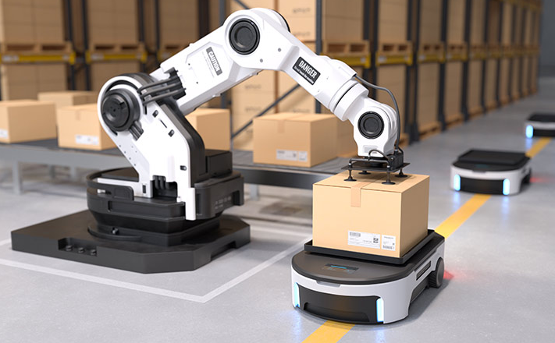
Warehousing Robots
Robots built to automate warehouse operations, such as inventory management, product sorting, and order fulfillment.
Can work independently or alongside humans to improve efficiency, speed, and accuracy.
Help reduce manual labor, minimize errors, and optimize logistics workflows.
Example: Autonomous Picking Robot
Deployed in large e-commerce warehouses.
Identifies, picks, and transports items from shelves to packing stations.
Streamlines the picking process, reduces workload on staff, and speeds up order delivery.

Slide 9
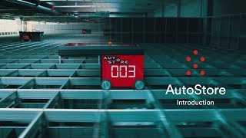
Warehousing Robots

Slide 10
Warehousing Robots
Features and Capabilities
Navigation: Equipped with sensors (cameras, lidar, laser scanners) to map and navigate autonomously, avoid obstacles, and adapt to dynamic environments.
Inventory: Interfaces with Warehouse Management System (WMS) for real-time stock data, item locations, and order priorities.
Object Recognition: Uses computer vision and image processing to identify items, read barcodes, and match products to orders.
Manipulation & Grasping: Robotic arms and grippers handle various items (boxes, bags, packages) with precision and care.
Collaboration: Works alongside human workers—shares order info, navigates to shelves, and assists in item picking for optimal workflow.

Slide 11
Warehousing Robots
Workflow
Order Assignment: WMS assigns orders with item details and quantities to the robot.
Navigation: Robot plans an optimized path to the target shelf using mapping and sensors.
Object Recognition: Identifies the correct item using vision systems or barcode scanning.
Grasping & Retrieval: Picks the item securely using robotic arms and grippers.
Order Completion: Places item in a container or hands off to a human for packing.
Repeat: Continues picking efficiently across multiple orders and locations.

Slide 12
Warehousing Robots
Benefits
Increased Efficiency: Speeds up order picking and fulfillment, operates 24/7 without fatigue, boosting overall productivity.
Accuracy & Quality: Minimizes picking errors with precise object recognition and handling—ensures correct items, fewer complaints.
Labour Optimization: Automates repetitive tasks, allowing human workers to focus on quality control, inventory, and customer service.
Scalability: Easily adapts to growing e-commerce demands, handling changing inventory volumes and order patterns.
Facts: Robophobia is an anxiety disorder in which a person has an irrational fear of robots.

Slide 13
Thanks For Joining
^_^

